Slide 1
Theodore C. Friedman, M.D., Ph.D. (the Wiz) Professor of Medicine-UCLA Chairman, Department of Internal Medicine Charles R. Drew University Dr. Friedman’s Endocrinology Clinic Brief Update on Compounded Tirzepatide vs Semaglutide for patients with endocrine problems Join on Facebook Live - https://www.facebook.com/goodhormonehealth GoodHormoneHealth Webinar March 23, 2025

Slide 2
Semaglutide (Ozempic)
Semaglutide (Ozempic) is a diabetes medicine that leads to profound and sustained weight loss.
It is not an amphetamine like drug so patients who have side effects on Phentermine or Phendimetrazine are likely to tolerate Ozempic.
To avoid side effects including nausea (which is common) and feeling full, it is recommended to go up gradually on the dose of Ozempic (0.25 mg weekly for 1 month, then 0.5 mg weekly for 1 month, then 1 mg weekly).
Some patients do fine on a lower dose.
The 2 mg dose has recently been approved and patients can go right from the 1 mg dose to the 2 mg and get an additional weight loss effect.
I recommend taking the 2 mg dose every 10 days for the first 2 doses.
If you get mild nausea, go down to a lower dose (go to 0.25 mg a week, if on 0.5.mg).
We can prescribe Zofran for the nausea
Now compounded Semaglutide (Ozempic) is available

Slide 3
Mounjaro (tirzepatide)
Mounjaro (tirzepatide) is a newer diabetes drug that is called a dual incretin (GLP-1 plus GIP).
Zepbound (tirzepatide) is FDA-approved for weight loss
It has very impressive weight loss properties with patients on the highest dose losing up to 25 pounds.
It can reverse sleep apnea and get patients off CPAP
It is given once a week like Ozempic and has similar side effects as Ozempic including nausea, diarrhea, decreased appetite, vomiting, constipation, indigestion, and abdominal pain.
But the nausea side effect is considerably less due to the GIP
The doses are 2.5 mg, 5 mg, 7.5 mg, 10 mg, 12.5 mg, or 15 mg per 0.5 mL in single-dose pen and a patient should stay on the same dose for 4 weeks and only go up the higher dose if no side effects are present.
Some patients do fine on a lower dose.
Now compounded Mounjaro (tirzepatide) is available

Slide 4
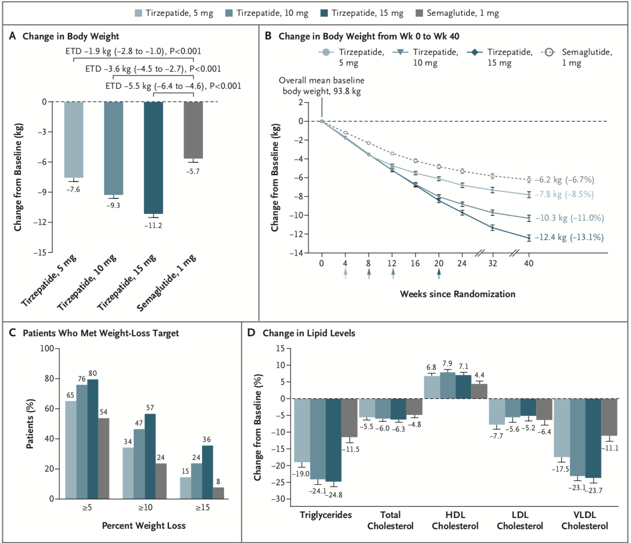
Effect of Once-Weekly Tirzepatide, as Compared with Semaglutide, on Body Weight, the Percentage of Patients Who Met Weight-Loss Goals, and the Lipid Profile.
Frías JP et al. N Engl J Med 2021;385:503-515
Notes:
Figure 2 Effect of Once-Weekly Tirzepatide, as Compared with Semaglutide, on Body Weight, the Percentage of Patients Who Met Weight-Loss Goals, and the Lipid Profile. Least-squares means (±SE) are presented, unless otherwise noted. Error bars indicate the standard error. Panel A shows the change from baseline in body weight at 40 weeks, as assessed with analysis of covariance with multiple imputation for treatment for missing weight at 40 weeks (treatment-regimen estimand). ETDs are least-squares means (95% confidence interval) at 40 weeks in the modified intention-to-treat population. Panel B shows the change from baseline in body weight over time, derived from a mixed-model repeated-measures analysis (efficacy estimand). The percent changes from baseline values at 40 weeks are shown in parentheses. Arrows indicate the times at which the maintenance doses of tirzepatide (5 mg, 10 mg, or 15 mg) and semaglutide 1 mg were achieved. Panel C shows the percentage of patients who had body-weight reductions of at least 5%, 10%, or 15% from baseline to week 40 (treatment-regimen estimand). The percentage was calculated with the use of Rubin’s rules by combining the percentages of patients who met the target in imputed data sets. Panel D shows the percent change (±SE) from baseline in lipid levels at 40 weeks, as estimated with the use of log transformation. HDL denotes high-density lipoprotein, LDL low-density lipoprotein, and VLDL very-low-density lipoprotein.

Slide 5
How do you get insurance coverage?
Call up your insurance to see if they cover weight loss medicines (many don’t cover at all).
Ask the criteria for coverage and if there is a pre-auth form
Ask what the criteria for coverage of Ozempic is (do you have to diabetes or does insulin resistance or pre-diabetes qualify or PCOS qualify)
If no coverage for these medicines, appeals or face-to-face appeals are unlikely to be successful.
Go to compounded options

Slide 6
Compounding Pharmacies that Compound GLP-1RAs
With the increasing demand for GLP-1RAs, high commercial cost and limited supply, compounded pharmacies started compounding these drugs for the patients at a fraction of the cost of brand-name drugs at commercial pharmacies.
They were allowed to do this because the FDA deemed that there was a shortage of brand-name drugs,
Since they were compounding Tirzepatide and Semaglutide and not the brand-names Ozempic, Wegovy, Mounjaro and Zepbound,
And because they were able to supply in-between dose or added ingredients such as Glycine + B12.
The landscape for compounded weight loss medicines is changing rapidly.
Some availability depends on the state you live in.

Slide 7
Compounding Pharmacies that Compound GLP-1RAs
In October 2024, the FDA under influence from Lilly declared the shortage of Mounjaro and Zepbound “resolved” and told compounding pharmacies to stop distributing compounded versions of these drugs.
However, the shortage of Mounjaro and Zepbound was not over and there is legal action between compounding pharmacies and the FDA.
In March 2025, a U.S. federal judge denied an injunction that would have allowed compounding pharmacies to keep making copies of Eli Lilly's weight-loss and diabetes drugs Zepbound and Mounjaro (generic name Tirzepatide) in the United States.
This was based on Lilly saying the shortage of Zepbound and Mounjaro has ended which most experts say is not true.

Slide 8
Compounding Pharmacies that Compound GLP-1RAs
The Outsourcing Facility Association (representing compounded pharmacies) that filed the lawsuit said that the number of patients taking compounded GLP-1s as in the millions, so banning compounding pharmacies from providing these medicines will cause a shortage.
This injunction does not affect the Novo Nordisk’s drugs Ozempic or Wegovy (generic name Semaglutide), until April 2025.
Hundreds of Dr. Friedman’s patients have benefited from these compounded GLP-1s which are available in syringes allowing individual dosing that is not possible with the commercial medicines.
Compounded GLP-1s do not require insurance pre-authorization and are much more affordable

Slide 9
Compounding Pharmacies that Compound GLP-1RAs- March 2025
Dr. Friedman works with several compounding pharmacies to provide affordable and safe GLP-1 drugs that have improved patients’ health and weight.
Dr. Friedman has communicated with representatives from the three compounding pharmacies he works with University Compounding Pharmacy (UCP), Strive Pharmacy and Empower Pharmacy and each pharmacy with each companies’ availability below.
Dr. Friedman’s philosophy is that compounded pharmacies are supplying “Tirzepatide” and “Semaglutide” and not “Ozempic”, “Wegovy”, “Zepbound” and “Mounjaro” and that they are supplying customized dosing that are not available with the fixed doses supplied by the pharmaceutical companies.
Overall, Dr. Friedman prefers Tirzepatide over Semaglutide as it gives more weight loss and less side effects, but is not currently available in CA.
While for new patients, Dr. Friedman advises a single vial to insure it works and side effects don’t occur, for patients on the compounded GLP-1s to order 3 vials.

Slide 10
Response from companies that supply compounded GLP-1a
According to the Wall Street Journal, Hims & Hers referred to a March 2 social-media post by Chief Executive Andrew Dudum saying the firm would stop selling commercially available doses in mid-May but would keep providing compounded versions if they have been getting a personalized dosing regimen.
Thus, the personalized dosing regimen of GLP-1s (syringes that allow patients to adjust dosing) may allow them to continue to supply these compounds.

Slide 11
Will Compounding Pharmacies be allowed to continue to Compound GLP-1RAs
Although he cannot predict the future, Dr. Friedman expects compounding pharmacies to come up with alternatives to continue to supply these drugs and expand their use as providers realize these are good options for patients.
Big pharma has a lot at stake to try to quench compounding pharmacies.

Slide 12
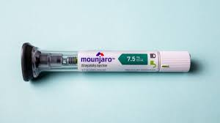
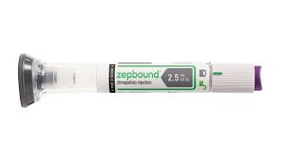
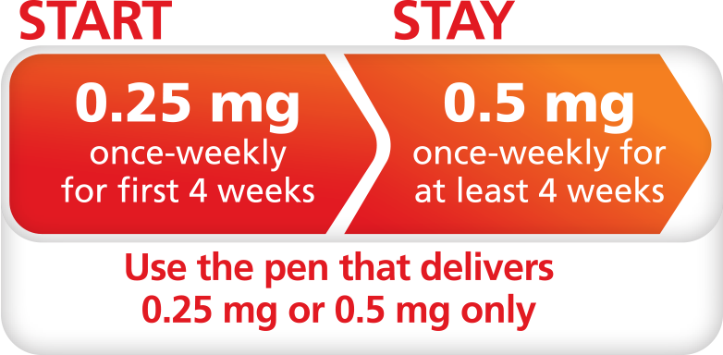
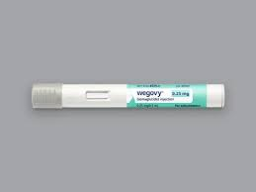
Individual Dosing
Another advantage of GLP-1RAs from compounding pharmacies over brand name products is that compounding pharmacies prescribed vials and syringes, so the dose can be individualized, while Wegovy, Zepbound and Mounjaro come as single-use, fixed-dose cartridges.
Ozempic is designed for multiple fixed-dose delivery, but by using “clicks” patients can give individualized dosing.

Slide 13
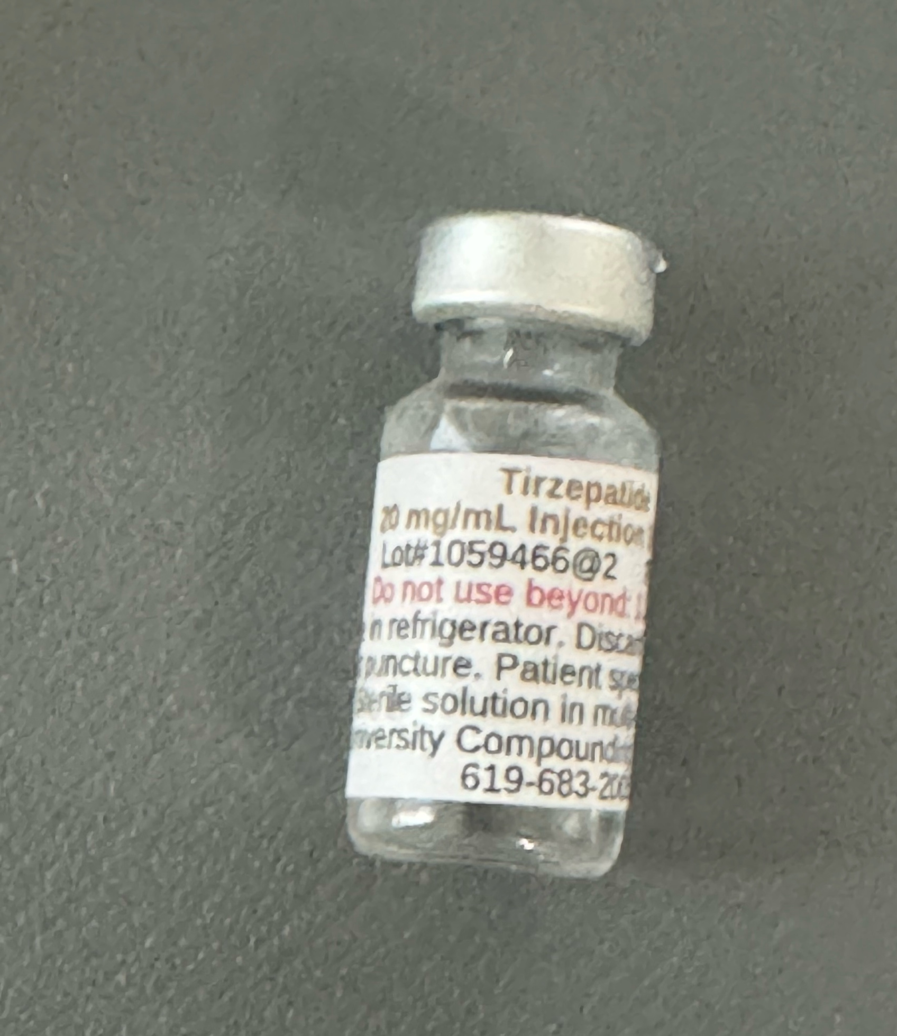
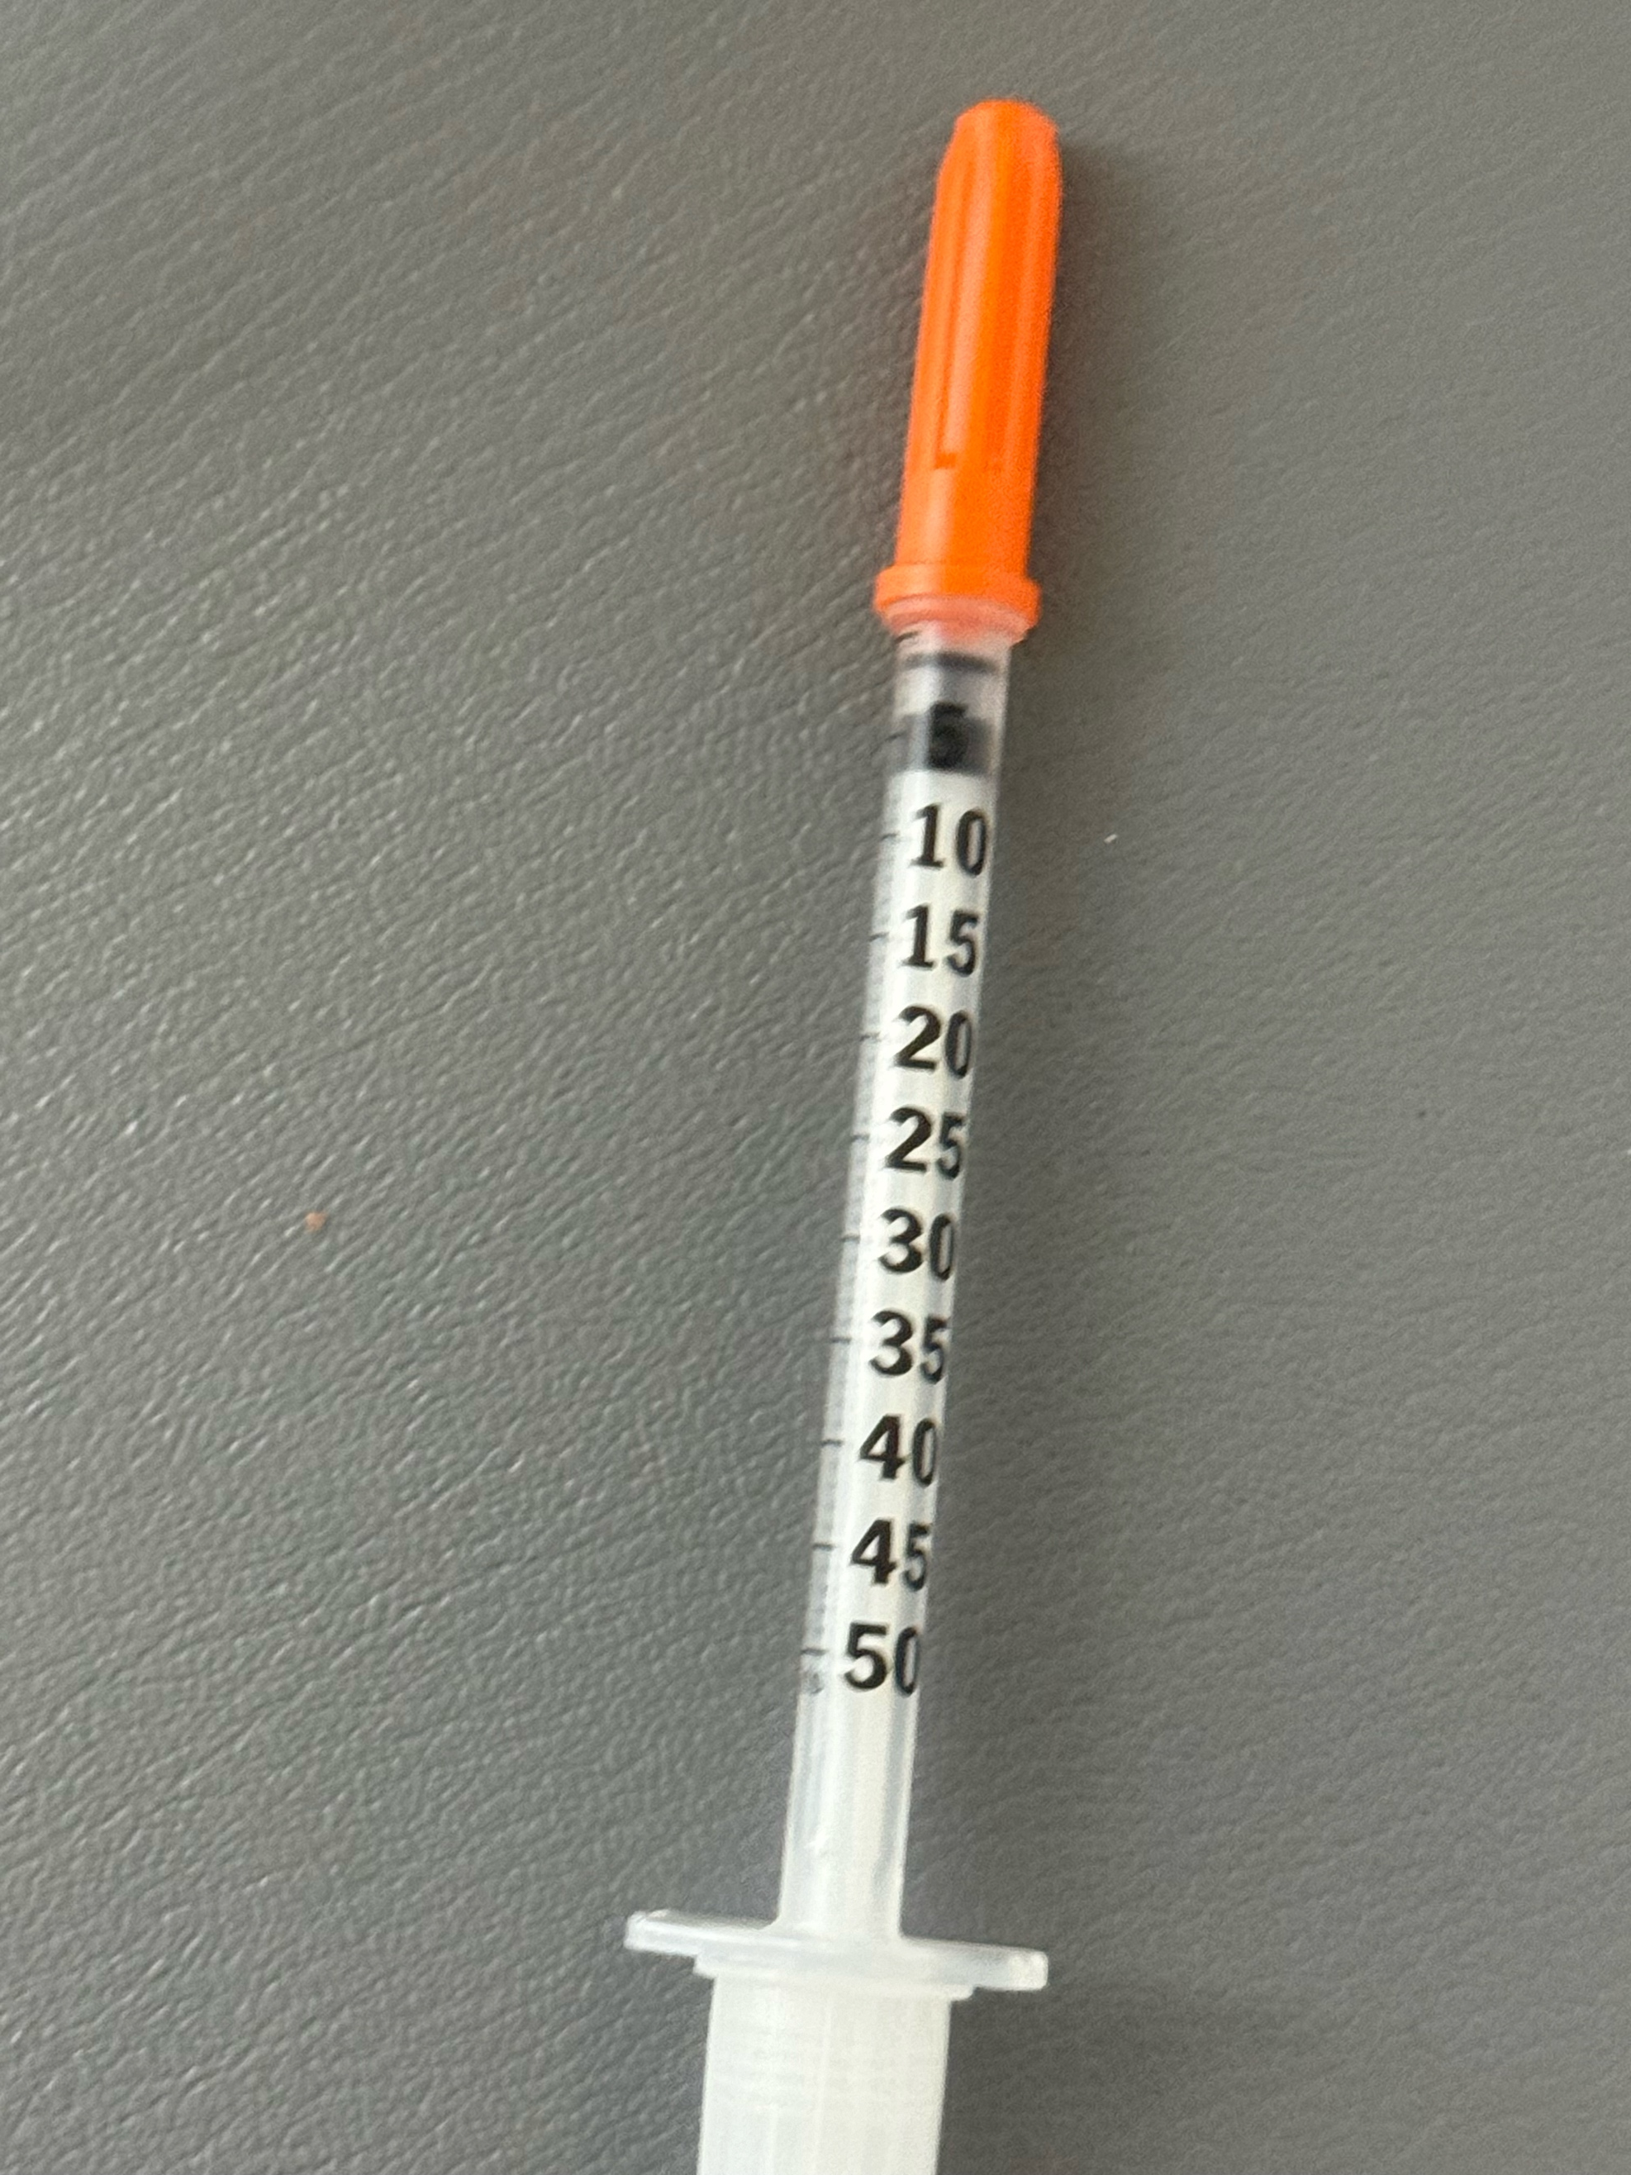
Individual Dosing
In contrast, compounding Semaglutide and Tirzepatide can be given in whatever dose the patient and doctor decide on.
Patients can start on a very low dose (micro-dosing) and work their way up, so side effects are minimized.
Patients have the leeway to adjust their own dose depending on appetite suppression and side effects, as well as costs.
This is a major advantage of the compounded drugs.

Slide 14
UCP
Tirzepatide injections have been discontinued but they may have sublingual Tirzepatide (10 mg/mL) with a typical starting dose of 5 mg under the tongue twice a week and up to 10 mg under the tongue twice a week in 1 month.
Price for 10 mL (lasts about 2 months) is $199. 20mL is $299
Compounded Semaglutide/ B12 FIVE is available until April 22, 2025 and is available in 44 states including Califormia. A 5 mg vial that last about 2 months is $299.
UCP also has Semaglutide (TWO) with Cyanocobalamin (B12) 2 mg-0.4 mg/mL #1 mL (2 mg of Semaglutide /vial) - Price $199
UCP collects payment and shipping and billing information after an order from Dr. Friedman

Slide 15
Strive Pharmacy
Strive Pharmacy, which compounds Semaglutide (brand name Ozempic, Wegovy), and Tirzepatide (brand name Mounjaro, Zepbound) is a 503B compounding pharmacy that offers GLP-1RAs to patients at a low price in 31 states including California (but not Tirzepatide).
For Strive pharmacy, patients pay Dr. Friedman directly.
Dr. Friedman will ask the patient for a PayPal payment of $299 with instructions to submit the PayPal receipt, state of residence, preferred drug and number of vials.
There are 3 options available at Strive Pharmacy, as seen in this table:
Strive | How to order | Mg per vial | Use for which dose | Theoretical doses per vial* | Cost per vial* | State
Semaglutide# | 2.5 mg/ml - 2 ml vial | 5 mg | 0.25 mg weekly for 4 weeks, then .5 mg weekly for 4 weeks, then 1 mg weekly for 2 weeks | 10 | $299 | CA
Semaglutide/Glycine/B12 | 5mg/5mg/1mg/mL 2 ml vial | 10 mg | 0.25 mg weekly for 4 weeks, then 0.5 mg weekly for 4 weeks, then 1 mg weekly for 7 weeks | 15 | $299 | Out of CA
Tirzepatide/Glycine/B12 | 10mg/5mg/500mcg/mL 2 ml vial | 20 mg | 2.5 mg weekly for 4 weeks, then 5 mg weekly for 2 weeks | 6 | $299 | Out of CA

Slide 16
Empower compounding pharmacy
Empower compounding pharmacy ships to all states but CA, WI and IA
Patients pay Empower directly.
Empower* product | How to order | Mg per vial | Use for which dose | Theoretical doses per vial | Cost per vial**
Semaglutide / Cyanocobalamin | 1/0.5 mg/mL 1 mL Vial | 1 mg | 0.25 mg weekly | 4 | 94.68
Semaglutide / Cyanocobalamin | 1/0.5 mg/mL 2.5 mL Vial | 2.5 mg | 0.5 mg weekly | 5 | 118.96
Semaglutide / Cyanocobalamin | 5/0.5 mg/mL 1 mL Vial | 5 mg | 1 mg weekly | 5 | 132.18
Semaglutide / Cyanocobalamin | 5/0.5 mg/mL 2.5 mL Vial | 12.5 mg | 2mg weekly 2.4 mg weekly | 6 5 | 219.49
Tirzepatide / Niacinamide | 8/2 mg/mL 2.5 mL Vial | 20 mg | 2.5 mg weekly 5 mg weekly | 8 4 | 188.20
Tirzepatide / Niacinamide | 17/2 mg/mL 2 mL Vial | 34 mg | 7.5 mg 10 mg | 4 3 | 308.53
Tirzepatide / Niacinamide | 17/2 mg/mL 4 mL Vial | 68 mg | 10 mg 12.5 mg 15 mg | 6 5 4 | 559.21
** Plus overnight shipping charges of $41

Slide 17
How long are the compounded vials good for?
Officially, the CDC recommends most multidose vial be discarded 28 days from first puncture.
However, UCP has performed potency, stability, and sterility testing which allows them to guarantee the medication unopened for 50 days and is doing testing that confirms that.
Dr. Friedman recommends that refrigerated unopened vials can be used for a year and refrigerated open vials can be kept for 90 days.
We usually start with one vial to make sure you don’t have side effects and can refill it for one to three vials.

Slide 18
What dose does Dr. Friedman recommend? How much is a unit?
For weight loss, Dr. Friedman recommends the lowest dose that gives appetite suppression and does not give side effects.
To avoid side effects, Dr. Friedman recommends a slow increase in the dose.
For Tirzepatide from UCP, Dr. Friedman recommends starting at 2 mg (0.1 mL=10 units) weekly for a month, then 4 mg (0.2 mL=20 units) weekly for a month, then 6 mg (0.3 mL=30 units) for the next month.
Patients with a history of side effects to GLP-1RA or concern about dosing can start at 1 mg (0.05 mL= 5 units) and those who have been on GLP-1RA before can start at a higher dose such as 5 mg (0.25 mL=25 units).

Slide 19
What dose does Dr. Friedman recommend? How much is a unit?
If patients have been off GLP-1RA for more than a month, Dr. Friedman recommends starting back at a lower dose.
If off for less than a month, the same dose can be restarted.
The maximum dose of Tirzepatide is 15 mg a week, however the cost is greater at that dose.
Some patients continue to lose weight on a low dose, while others need to keep increasing the dose.
If you are at your target weight, you can go on a low dose maintenance dose (2 mg)
A unit is the markings on the syringe. 10 units equal 0.1 mLs.

Slide 20
What dose does Dr. Friedman recommend? Semaglutide
For Semaglutide, Dr. Friedman also recommends the lowest dose possible with a gradual increase in dosing.
The maximum dose is 2.4 mg/week, but the cost goes up with higher doses.
A typical dosing regimen is 0.25 mg weekly for 4 weeks, then 0.5 mg weekly for 4 weeks, then 1 mg weekly for 4 weeks and then increase to 2 mg weekly depending on budget.

Slide 21
Tirzepatide vs Semaglutide
Dr. Friedman recommends Tirzepatide over Semaglutide for most patients
Patients on Semaglutide can switch to Tirzepatide if they get side effect or stop losing weights.
Occasionally, some patients do better on Semaglutide than Tirzepatide.
If you are taking GLP-1RAs for diabetes, please discuss dosing at your appointment.

Slide 22
Side effects of Tirzepatide and Semaglutide
The most common side effects for both drugs include nausea and constipation.
Patients also report acid reflux, fatigue, stomach pain, vomiting, burping and diarrhea.
Depression and anxiety often improve, but can worsen.
Muscle loss can occur, and Dr. Friedman recommends increasing protein intake (plant-based protein, if possible).
The side effect of nausea is less common with Tirzepatide and can be minimized with both drugs by eating small meals and drinking a lot of fluid.
Dr. Friedman can prescribe Zofran for nausea if needed.
Both drugs should not be used if the patient or any family members have been diagnosed with Multiple Endocrine Neoplasia Syndrome Type 2 or Medullary thyroid cancer (rare).
Other types of thyroid cancer are okay.

Slide 23
How do I get Tirzepatide and Semaglutide ?
Must be an active, current patient and will discuss risks and benefits at your appointment.
I usually don’t give on the first appointment while I am sorting out your endocrine problem
We usually start with one vial and give a refill if needed until your next appointment
Appointments every 3 months are needed.
Because of the changing nature of compounded GLP-1 availability and individualized dosing, Dr. Friedman recommends a 10 minute appointment to discuss options.

Slide 24
Questions and comments
Patients to share their experience on Facebook

Slide 25
For more information/to schedule an appointment
Talk will be posted at www.goodhormonehealth.com in a few days
Please email us at mail@goodhormonehealth.com

