Slide 1



How to Stay Alive if have no adrenals (BLA and Addison’s)-in memory of Dr. Friedman’s patients who passed away from adrenal insufficiency
GoodHormoneHealth Webinar
January 19, 2025
All patients will be muted, but if you are unmuted, please mute your phone

Slide 2
What we will discuss tonight
What happened to Madonna Ramp and Taylor Rousseau Grigg?
How do you optimally replace adrenal hormones?
What laboratory tests are needed to monitor replacement?
When and how do you stress dose?
What do you if you are having surgery?
What do you if you are hospitalized?
What about subcut cortisol versus cortisol pumps?

Slide 3


MR
Dr. Friedman's patient Dr. Madonna Ramp tragically passed away on November 12, 2024.
She needed high doses of steroids and did well on them
Dr. Friedman was her only doctor who did not think she needed to taper off them.
She had adrenal insufficiency and was hospitalized for the last 5 months of her life.
Dr. Friedman did talk to the resident in a hospital taking care of her and advising him against tapering her steroids
Madonna is at least the fourth patient of Dr. Friedman who tragically passed away who had adrenal insufficiency.
Dr. Friedman heard about Madonna's death from his patient Erin who said "Patients with adrenal insufficiency need to be taken seriously"

Slide 4
MR (obituary)
Dr. Madonna Nicole Ramp, 43, passed away on November 12, 2024, in Las Vegas, NV after a long battle with multiple illnesses.
Madonna was born on April 14, 1981, in Jackson, MI to Daniel Ramp and Madonna Chapin. She attended St. John's Elementary School, J.C.M.S., and Lumen Christi while living in Jackson. During her years in school, she was active with many different sports, clubs, and youth groups. She ultimately moved to Paw Paw, MI before her senior year of high school, and graduated from Paw Paw High School. on May 23, 2018.
To say Madonna was a free spirit would be an understatement. She loved moving to the beat of her own drum and trying to push the envelope to get others to think critically. Elvis, music, dancing, poetry, and catching up with her loved ones were some of the most important things to her! She also valued moving and growing, so no one person or place could tie her down for long!
Madonna was a valued member of many communities! She came from a large family and built an even larger family throughout the world! She is preceded in death by her father, Daniel, and her mother, Madonna. While Madonna is no longer physically on Earth, the legacy she left behind will live on! She loved being in service to others, so in lieu of flowers, please make a donation to the Listening Ear Crisis Center in East Lansing, MI, or another charity of your choice, in her name.
May her memory be a blessing

Slide 5

Taylor Rousseau Grigg
Dr. Friedman was interviewed by Yahoo about the passing of TikTok star Taylor Rousseau Grigg who also died on Addison's disease (https://www.yahoo.com/lifestyle/tiktok-star-taylor-rousseau-grigg-died-after-complications-from-addisons-disease-family-says-what-to-know-about-the-rare-condition-214751924.html)
TikToker Taylor Rousseau Grigg died at just 25 of complications of Addison’s disease and asthma, her family told Today.com. Rousseau Grigg’s death last week was “sudden and unexpected,” her husband, Cameron Grigg, said in an Oct. 5 Instagram post.
The young TikToker had risen to prominence posting about her life. She shared that she’d received a diagnosis in an Aug. 8 “health update” but didn’t specify what her condition was. Experts say that Addison’s disease is rare but can quickly become life-threatening if it’s not managed properly.

Slide 6
Taylor Rousseau Grigg
What are the symptoms?
Addison’s disease manifests with a “constellation” of symptoms, Dr. Theodore Friedman, an endocrinologist and chair of the department of internal medicine at Charles R. Drew University, tells Yahoo Life. Those include fatigue, weight loss, nausea, diarrhea, abdominal pain, joint or muscle pain, dehydration, low blood sugar and cravings for salty food. It can also cause hyperpigmentation, or a darkening of the skin that can make people appear bronzed.
Rousseau Griggs said in her August health update that she was at times “in bed writhing in pain” and felt too weak to carry a suitcase or walk to the mailbox. She added that she had found out what was ailing her only a few months prior and was “struggling that whole time, feeling like I was going to die.”
While the symptoms tend to develop slowly over time, they can worsen quickly in some cases, Friedman says. “You can be healthy one day and sick the day after,” he explains. “It can happen really fast.” Most people are diagnosed between the ages of 20 and 50 as the condition’s chronic effects accumulate, according to the Cleveland Clinic.
Cappola and Friedman tell Yahoo Life that people with Addison’s usually have to take one or two medications to replace the hormones their body is underproducing: hydrocortisone, a steroid that supplements cortisol, and fludrocortisone, to replace a second hormone called aldosterone. The latter helps keep the body’s water and salt levels balanced, the Cleveland Clinic says, so people with Addison’s may need to consume more sodium when they’re exercising.

Slide 7
Taylor Rousseau Grigg
How Addison's can turn fatal
The disease has to be carefully managed. The body needs cortisol at all times, “but you particularly need cortisol in times of physical stress,” explains Cappola. The body’s cortisol demands can fluctuate drastically throughout the day and “spike up in times of stress, like an infection.”
That’s particularly dangerous when a patient’s body is trying to fight off a cold or other illness. “An infection causes you to chew through [your steroids], then you can’t fight the infection anymore,” explains Friedman. People with Addison’s need an extra dose of cortisol, often in injection form, during these times because their bodies won’t make enough to meet the demand on their own.
The biggest concern, however, is that the drop in cortisol triggers adrenal crisis, and when there isn’t enough of the hormone, “the main thing you’d see is that blood pressure would start to drop, and if your blood pressure isn’t high enough for a long time, you can die from it,” says Cappola.
Dr. Friedman often sees high blood pressure with adrenal crisis.

Slide 8
Taylor Rousseau Grigg
While it’s not clear what exactly happened to Rousseau Grigg, both experts say that a combination of adrenal crisis from Addison’s and asthma could become deadly. “The asthma attack itself might not be it,” says Cappola. “But she might’ve had some kind of upper respiratory infection that precipitated an asthma attack and precipitated adrenal crisis. You can die from either one.”
Cappola points out that being newly diagnosed could mean that Rousseau Griggs was less prepared to understand what was happening or how to manage it. She adds that the drop in blood pressure during adrenal crisis could have impaired judgment and made it harder to get help or more medication in time.

Slide 9
Taylor Rousseau Grigg
Addison's is rare — but health problems related to steroids aren't
Both experts say that unless a patient has had ongoing symptoms (which would warrant a doctor’s visit), Addison’s is a rare diagnosis that most people likely don’t need to worry about. “What should reassure you is that the body has a lot of built-in duplication of adrenal tissue that makes these hormones,” says Cappola. “It really takes a chronic destructive process to get to the point where someone develops these symptoms.”
While corticosteroids like hydrocortisone and prednisone are helpful for people with Addison's, Cappola warns people against taking the medications without a doctor's recommendation. “Be careful taking corticosteroids like hydrocortisone or prednisone,” warns Cappola. “There are people out there who think that they have adrenal fatigue and take these [as] supplements, and they shouldn’t; you don’t want to mess with those adrenal glands.” That’s because if you take steroids long term and stop abruptly, your body can go into adrenal crisis, even if you don’t have Addison’s.

Slide 10
Taylor Rousseau Grigg (Comments on postings)
Tragic
Terribly sad
My condolences to her family. she was bright and beautiful.
She kept it to herself
With all respect, this should not have killed her. RIP Young lady, you had poor medical care.
She specifically stated that she was tired of people telling her what she should do about her own health issues. that’s why she kept it to herself. that was her right.

Slide 11
Lessons learned
Don’t keep it to yourself
Learn about your disease
See a specialist, but even that may not help

Slide 12
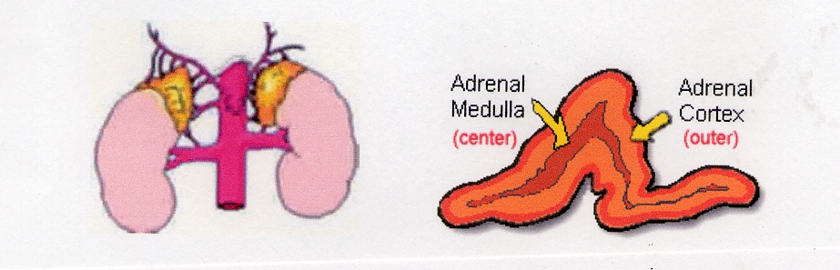
Adrenal Glands
The adrenal glands lie at the superior pole of each kidney.
They are composed of two distinct regions: the cortex and the medulla.

Slide 13
Adrenal Hormones
Glucocorticoids-Cortisol
Mineralocorticoids-Aldosterone
Androgens-DHEA(S), testosterone, androstenedione
Estrogens
Catecholamines-Epinephrine, Dopamine

Slide 14
Cortisol
Daily secretion 10-15 mg
Circadian cycle (highest at 8 am)
Has three forms:
  Free (5%), physiologically active
  bound to CBG/albumin
  Cortisol metabolites

Slide 15
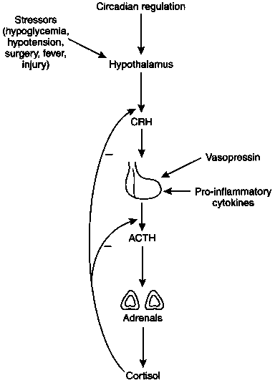
Cortisol (glucocorticoid): Brain-Hypothalamic-Pituitary-Adrenal Axis

Slide 16
Renin-Angiotensin-Aldosterone (Mineralocorticoid) Axis
Site
Liver
Angiotensinogen (452 A.A.)
Kidney
Prorenin
Renin
Angiotensin I (10 A.A.)
Lung,
Angiotensin-
Plasma
converting enzyme
Angiotensin II (8 A.A.)
Adrenal,
Angiotensin II receptor
Vascular
Adrenal
Aldosterone

Slide 17
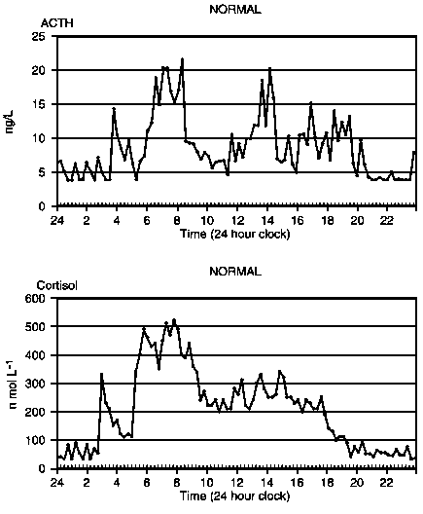
Daily ACTH/Cortisol Trends

Slide 18
Different Types of Glucocorticoid Insufficiency
Primary Adrenal Insufficiency
  Glucocorticoid and Mineralocorticoid Insufficiency
  Compensatory Increase in POMC (hyperpigmentation)
  Bilateral Adrenalectomy
Secondary (Central) Adrenal Insufficiency
  Glucocorticoid Insufficiency Only
Glucocorticoid Withdrawal
  Glucocorticoid Insufficiency Only

Slide 19
Symptoms of Glucocorticoid Insufficiency
GI issues (most common and most GI issues in adrenal insufficiency patients are due to cortisol problems, not GI problems)
Fatigue
Vomiting
Diarrhea
Anorexia
Malaise
Muscle and joint pain
Abdominal pain
Weight loss
Hypoglycemia
Hyponatremia (SIADH)

Slide 20
Symptoms of Mineralocorticoid Insufficiency
Decreased intracellular volume
Tachycardia, palpitations (most palpitations are due to fludrocortisone/HC issues and not GI issues
Hypotension
Dehydration
Shock
Hyponatremia
Hyperkalemia
  Arrhythmias
Acidosis
Salt-craving

Slide 21
Laboratory Findings of Primary Adrenal Insufficiency
Hyponatremia
Hyperkalemia
Hypoglycemia
Lymphocytosis
Eosinophilia
Mild normochromic Anemia
Notes:
Elevated eos- clin endo metab 1985 14 947-76
j of endo 1994 69-80

Slide 22
Adrenal Insufficiency Treatment
Proper replacement is key to good quality of life
Both too much and too little is bad
Glucocorticoids (lots of choices) and fludrocortisone
Notes:
Is 20 an absolute or relative number to baseline cortisol value?
In secondary, adrenal atrophic b/c of low acth levels but can still respond to high dose acthbut not to low dose/physiiologic doses

Slide 23
Quality of Life
In a postal survey of patients with primary adrenal failure from Norway, the SF 36 was used to assess subjective health status.
Seventy-nine out of 97 patients (81%) responded.
General health and vitality perception were most consistently impaired in the patients with Addison’s disease.
Scores for fatigue (both physical and mental) were also higher than normal (i.e. more fatigue).
24% of patients in the 18–67 years age range and 41% of patients in the 40–67 years age range were out of work and receiving disability beneﬁt, compared to 10% and 17%, respectively, in the general population.

Slide 24
Daily cortisol production rate in man
Esteban et al. (JCEM, 72: 39, 1991) measured daily cortisol production rates in normal volunteers with a stable cortisol isotope method.
10 mg a day
Not all of oral cortisol is absorbed, need to take 12-15 mg/day
Most glucocorticoid replacement is supraphysiological.
Leads to osteoporosis, glucose intolerance and increased infections.
Main problem is malabsorption (cortisol is needed for adsorption, so it can be a vicious cycle)

Slide 25
Physiological Equivalents of Glucocorticoids
20 mg of hydrocortisone (shortest acting)
15 mg of iv or subcut solucortef
4-5 mg of prednisone (longer acting)
4 mg of methylprednisolone (longer acting)
0.75 mg of dexamethasone (liquid dexamethasone 0.5 mg/ 5 mL) (longer acting, no mineralocorticoid activity)
Each of these can be used and may be better in some patients
Can be combined, if needed

Slide 26
Types of Glucocorticoids
I start with hydrocortisone and use it 90% of my patients
  Can monitor with UFC/17OHS, salivary cortisol day curves, can’t with others
I try the others next
  Prednisone
  Methylprednisolone (Medrol)
  Liquid dexamethasone
  Sometimes combinations
Try to adjust when patient is feeling low vs high

Slide 27
Glucocorticoid Replacement
Most patients are over-treated
Earliest manifestation of excess treatment is easy bruisability
Weight gain, central obesity, etc.
Earliest manifestation of inadequate treatment is joint pain, nausea, abdominal pain.
Reasonable to mimic circadian rhythm with most of cortisol given first thing in the morning
But patients often go through cortisol and need doses throughout the day
Want to avoid large doses at night as it could lead to sleep disturbances,
But, most patients need a bit of cortisol to go into deep sleep
No studies comparing different treatment regimens

Slide 28
Glucocorticoids are Needed for Sleep
García-Borreguero D. et al.
(J Clin Endocrinol Metab. 2000 85:4201-6).
In Addison's patients, cortisol plays a positive, permissive role in REM sleep regulation and may help to consolidate sleep.
Suggests a need for a low dose of hydrocortisone (1.25-2.5 mg) at night.

Slide 29

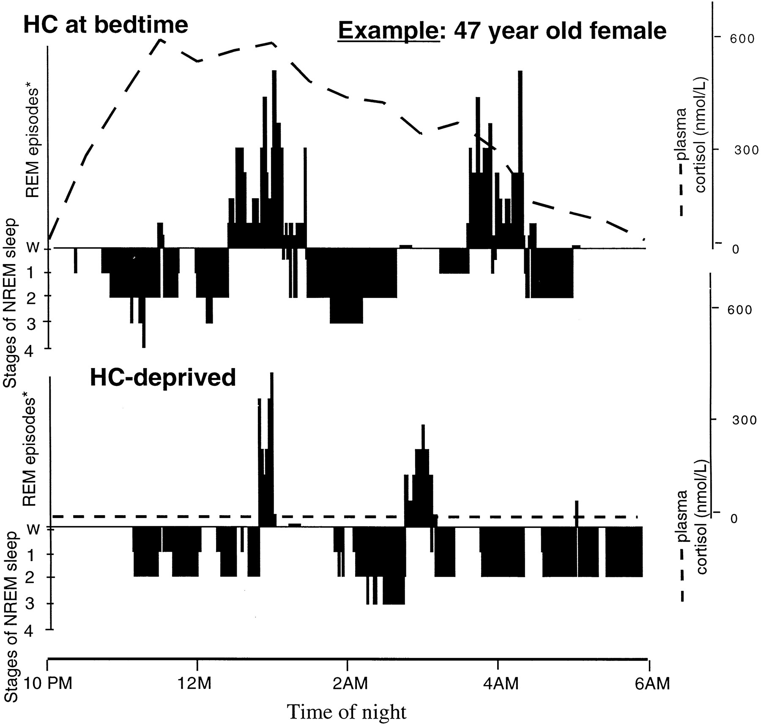

Figure 2. Representative sleep profile of an Addison’s patient, showing sleep stages during the HC at bedtime and ...
Notes:
Figure 2. Representative sleep profile of an Addison’s patient, showing sleep stages during the HC at bedtime and HC-deprived arms. *, Number of REM episodes per min of REM sleep.
Unless provided in the caption above, the following copyright applies to the content of this slide: Copyright © 2000 by The Endocrine Society

Slide 30
Glucocorticoid Replacement (2)
My approach is to start with hydrocortisone mainly in AM-aim for dose between 15 and 20 mg/day in a women and slightly higher in a man.
  Hydrocortisone 10-15 mg on awakening
  Hydrocortisone 2.5-5 mg in mid-afternoon
  Hydrocortisone 1.25- 2.5 mg at bedtime
  Occasionally a 4th dose at about 5 pm is needed
  More physiological than prednisone or dexamethasone
Decrease dose slowly until some symptoms develop, then go back a dose.
Small changes make a big difference
Increase dose with illness, short term its better to err on giving more, long term its better to give less

Slide 31
Glucocorticoid Replacement (3)
Dosing is crucial, might be a different between brand and generic
Cortef is brand name, hydrocortisone is generic (pharmacy can substitute different suppliers without telling patient or doctor)
Greenstone is the best generic
Other brands are CorePharma, Qualitest and West-ward
Comes in 5, 10 and 20 mg pills
Stick with a brand you like
No evidence of shortages

Slide 32
Maintenance Therapy for Primary Adrenal Insufficiency
Primary adrenal insufficiency may need a bit more glucocorticoids than secondary
Mineralocorticoid Replacement
  Start with Fludrocortisone 0.05 mg to 0.5 mg daily (0.05 mg twice a day)
  Titrate based on renin levels
  Should be given twice a day-half-life is 3.5 hrs
  Fludrocortisone is generic; brand (Florinef) is not available
  Probably will need more fludrocortisone in the summer
  No shortages
  Teva, Barr, Novitium, Zydusand Impax
Med-Alert Bracelet
Program your health tab in your phone
Solu-cortef -100 mg in Act-O-vial

Slide 33
Monitoring glucocorticoid replacement
Signs and symptoms
24 hr UFC over-estimate cortisol as it reflects amount in the urine right after dosing that exceeds 11b-HSD2 capacity.
17-OHS (mg/day) reflects cortisol metabolism and is more integrated throughout the day.
8 AM cortisol not helpful
ACTH is high (100-1000) unless over-replaced
If ACTH >1000, get a pituitary MRI to look for Nelson’s

Slide 34

Salivary day curve
Serum or salivary cortisol day curves under-estimate cortisol as the ignore cortisone-cortisol shuttle
Salivary cortisol day curves can be helpful to see pattern
Should be high in AM decline throughout the day
7 times a day 8AM, 11 AM, 2 PM, 5 PM, 8 PM, midnight, 4 AM
If a value is high, can reduce dose before

Slide 35
Monitoring glucocorticoid replacement (lessons from MR)
Signs and symptoms
Some patients need a high dose of steroids.
If they are doing well, have no complications from too much steroids (weight gain, rise in HbA1c, osteoporosis), can leave them on a high dose.

Slide 36
Monitoring mineralocorticoid replacement in primary adrenal insufficiency
Plasma renin activity is very accurate and probably should be measured every 2-3 months
Tube should be chilled and spun right away (labs aren’t good about this, probably okay)
If its high, more fludrocortisone is given, if its low, less fludrocortisone is given
Electrolytes are relatively insensitive and are not a substitute for frequent renin monitoring
If high blood pressure and normal renin, do not stop fludrocortisone, but give a blood pressure pill
Calcium channel blockers
  Amlodipine (Norvasc) or diltiazem (Cardiazem)
Do not give ACE inhibitors (benazepril, lisinipril), ARBs (losartan), spironolactone or diuretics

Slide 37
Salt and licorice
Use salt abundantly, especially if you are salt craving
Can take more before exercise
As long as you don’t have heart problems or hypertension, probably can take as much salt as you want
Licorice root inhibits the 11b-HSD enzyme allowing more cortisol to bind to the cortisol receptor in he kidney
Might be a good way to get more mileage from your cortisol and fludrocortisone
Licorice root from Nature’s Way 450 mg twice a day

Slide 38
DHEA
Only made by adrenal (0 if adrenalectomy)
I recommend 25 mg a day
May help with energy and immune system
Too much DHEA
  Oily skin
  Oily hair
  Acne

Slide 39
Testosterone
Half made by adrenals, half made by ovaries (regulated by the pituitary)
Most patients with BLA and prior pituitary surgery are low
Usually given by cream
2.5 mg/mL, 1 mL daily is a dose I often use
May help with energy, muscle strength, libido
Less side effects than DHEA
  Extra hair growth
  Acne

Slide 40
Typical Hormone Panel
Every 2-3 months
Renin-sitting is ok
ACTH
DHEAS
Electrolytes (maybe every 3-6 months)
Bioavailable and total testosterone
Pituitary hormones as needed
  IGF-1
  Thyroid hormones (freeT4, freeT3, TSH, rT3)
Gonadal hormones as needed (Estradiol)
24 hr UFC/17-OHS on replacement (every 6 months)
Salivary day curve every 6 months
No need to measure cortisol/do imaging (unless concerned about remnant tissue)
Don’t need to/can’t measure dopamine, catecholamines

Slide 41
Can someone with adrenal insufficiency?
Get a flu shot? Yes you should
Get steroid injections (back problems)? yes but minimize duration
Get oral steroids for asthma? yes but minimize duration
Use steroid inhalers? Yes
Use steroid creams? Yes
Get the COVID-19 vaccine? Why not?

Slide 42
COVID-19 and stress-dosing
Not as important as when I gave this talk in 2020
Make sure you drink fluids, take in salt.
I would stress dose by doubling your hydrocortisone, not tripling as Dr. Findling recommended.
See my quotes in Endocrine Today
https://www.healio.com/news/endocrinology/20200326/aace-statement-offers-covid19-guidance-for-people-with-adrenal-insufficiency-cushings-syndrome
Download Dr. Friedman’s adrenal crisis letter to bring to emergency rooms

Slide 43
Stress Dosing
Okay for short-term, try to avoid creeping up on your dose
  Fever
  Vomiting
Double glucocorticoid dose
Severe stress could add an extra 5 mg
Exercise or travel, could add an extra 2.5-5 mg of HC and .05 mg of fludrocortisone before
Some women need a a bit extra around their menses

Slide 44
Adrenal Crisis
Usually in Patients with Primary Adrenal Insufficiency
Precipitated by Stress (emotional or physical)
Newly diagnosed vs. established patient
  Stopped/ran out of medicines
  Illness (gastrointestinal and upper respiratory tract infections)
  vomiting

Slide 45
Adrenal Crisis-symptoms
GI issues (nausea, vomiting, abdominal pain, diarrhea)
Fatigue
High or low blood pressure
High pulse
Weak
Feel like passing out
Poor circulation

Slide 46
ACT-o-vial
https://www.pfizerhospitalus.com/products/solu-cortef
https://www.mskcc.org/cancer-care/patient-education/give-emergency-injection-using-solu-cortef-act-o-vial
100 -2 mL, 250-2 mL, 500-5 mL, 1000 mg-8 mL
Outer thigh
Have 2 or 3-home and purse
Make sure it doesn’t expire

Slide 47
Adrenal Crisis
Know when it is coming on
Double dose first, if still AI, 100 mg of IM hydrocortisone
Take extra fludrocortisone/extra fluid and salt
Give yourself a solucortef shot
Go to ER (bring crisis letter) if absolutely needed, but be prepared to wait
You may have to guide the ER doctor

Slide 48
Steroid coverage for illnesses or surgery
Moderate illness
  50 mg of hydrocortisone twice a day
Severe illnesses
  100 mg of IV hydrocortisone Q 8 hours
Minor procedures without anesthesia
  No extra coverage
  Colonoscopy: double oral HC and fludrocortisone day before and day of procedure. Or Single 100 mg IV dose of hydrocortisone prior to procedure and often 50 mg after
Moderately stressful procedures (endoscopy or arteriography
  Single 100 mg IV dose of hydrocortisone prior to procedure and often 50 mg after
Major surgery
  100 mg of IV hydrocortisone before anesthesia and Q 8 hours
  Next day double your dose

Slide 49
What to do if hospitalized?
Just get stabilized in the ER and go home
Get IV fluid, IV hydrocortisone and get checked for an infection
Get a cortisol level before treatment (?)
Have them call an Endocrinologist
Stay on high doses of steroids if infected.

Slide 50
Subcutaneous Cortisol
Useful in patients with gastro-intestinal issues that can’t absorb hydrocortisone
Uses solu-cortef in 100 mg Act-o-vial (reconstitute in 2 mL, so its 50 mg/mL) or 250 mg (reconstitute in 2 mL, so its 125 mg/mL)
Solu-cortef powder (now called Hydrocortisone 100 mg Powder for Solution) can reconstitute in 1 mL so it is 100 mg/mL-may make it easier to calculate
Solu-cortef in 500 and 1000 mg vial is available
Can use vial for a month in spite of what pharmacy may tell you
Dose 3-4 times a day similar to oral HC
May be able to cut down the dose slightly
I am recommending patients to try subcutaneous cortisol before pumps

Slide 51
Glucocorticoid Pump
JCEM Volume 99 Issue 5 - May 2014 Continuous Subcutaneous Hydrocortisone Infusion versus Oral Hydrocortisone Replacement for Treatment of Addison's Disease: A Randomized Clinical Trial
Marianne Øksnes, Sigridur Björnsdottir, Magnus Isaksson, Paal Methlie, Siri Carlsen, Roy M. Nilsen, Jan-Erik Broman, Kai Triebner, Olle Kämpe, Anna-Lena Hulting, Sophie Bensing, Eystein S. Husebye, and Kristian Løvås
The objective of the study was to compare the effects of continuous sc hydrocortisone infusion (CSHI) with conventional oral hydrocortisone (OHC) replacement therapy.

Slide 52
Glucocorticoid Pump Results
No significant differences between treatments in weight, waist to hip ratio, or BP were observed, although there was a tendency toward an increase in weight and body mass index (BMI) with CSHI
Morning glucose levels increased with CSHI and were significantly higher on CSHI than on OHC
No difference in sleep parameters

Slide 53
Glucocorticoid Pump Conclusions
Pumps can be used safely
High ACTH may be detrimental and is due to pause in cortisol replacement over night
Less fatigue but some weight gain with pump.
I have heard of patients getting infections
Some patients get abdominal welts
I would reserve the pump to those who failed oral HC and at least one other steroid preparations
I would recommend subcutaneous solu-cortef first

Slide 54
Glucocorticoid Pumps
Need to use an insulin pump (Tandem, Omnipod or Medtronics).
Insurances may cover one product and each pump has pluses and minuses.
The pump reservoir carries a maximum of 3 ml or 300 units of solution

Slide 55
Glucocorticoid Pump Reconstitution
If you use the solu-cortef powder, reconstitute 100 mg in 1 mL of saline or sterile water, so it is 100 mg/mL.
If you use a 100 mg Act-O-vial, reconstitute in 2 mL saline or sterile water, so it is 50 mg/mL.
If you use a 250 mg Act-O-vial, reconstitute in 2 mL saline or sterile water, so it is 125 mg/mL.
Some places refer to a 1:1 ratio, that is in units and refers to 100mg=100 units
Can use for a month

Slide 56
Typical Pump Dosing
Typical dose is around 25 mg/d, but this varies. Discuss with your endocrinologist.
Patients on inadequate doses of fludrocortisone as determined by a high renin may need higher doses, so fludrocortisone should be optimized Patients should start at higher and can be tapered down depending on symptoms and UFC/17OHS urine levels and at times, salivary cortisol day curves
The solu-cortef needs to be at a concentration of 100 mg/mL.

Slide 57
Sample Pump Dosing
8:00 am to 10:00 am, 1.8 mL/h
10:00 am-2:00 pm, 1.2 mL/h
2:00–8:00 pm, 0.5 mL/h
8:00 pm to 4:00 am, 0.25 mL/h
4:00–8:00 am, 2.5 mL/h.

Slide 58
Thanks for joining us
Questions? Please use the chat button
Thank you for sharing your time tonight!
If you have any more questions after tonight or want an appointment, please email: mail@goodhormonehealth.com
www.goodhormonehealth.com
Webinar will be posted in a few days

