Slide 1


Theodore C. Friedman, M.D., Ph.D.
(the Wiz)
Professor of Medicine-UCLA
Chairman, Department of Internal Medicine
Charles R. Drew University
Dr. Friedman’s Endocrinology Clinic
Dr. Friedman's Innovations with Cushing's Disease and New Cushing's Medicines
Adult division of the 30th Annual Magic Foundation Convention
Chicago
July 12, 2024

Slide 2

Outline
Dr. Friedman will discuss
Why use Medicines to to treat Cushing’s disease ?
What medicines to use to treat Cushing’s disease
Side effects and timing of the medicines
The use of ketoconazole for a medication trial before surgery
Longer-term treatment for Cushing’s
How to determine when a patient should go to surgery
Consensus panel how to work up a patient for Cushing's
Medicines affecting cortisol
Episodic vs Cyclic vs Variable Cushing’s
History of TSS

Slide 3
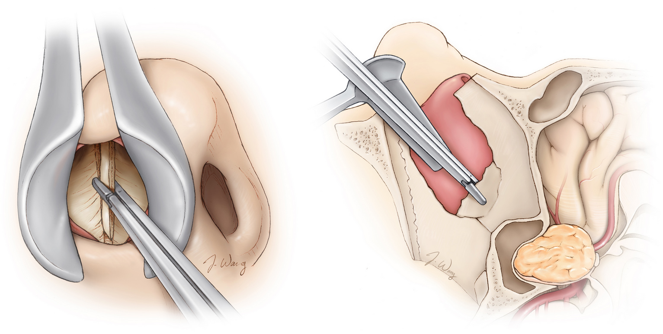
Transsphenoidal surgery (TSS)
Transsphenoidal approaches to pituitary tumors have undergone a rigorous test of time since the introduction of the first technique by Schloffer in 1907
T. Harvey W. Cushing performed his first transsphenoidal operation in 1909 in a patient with acromegaly by using a modified form of the Schloffer method to reach the pituitary gland.
Transsphenoidal surgery (TSS) was nearly abandoned in the late 1920s, followed by its renaissance in the late 1960s.

Slide 4
Transsphenoidal surgery (TSS)
The endoscope was first introduced to transsphenoidal surgery by Gerard Guiot in the early 1960s.
At the beginning, the endoscope was mostly used as a microscope-assisted tool to explore the sella cavity for residual tumor.
In 1997, the first clinical series of purely endoscopic pituitary surgery was reported by Jho and Carrau
Since then, many pituitary surgeons gradually shifted towards an endoscopic endonasal approach for pituitary adenomas and other parasellar tumors.

Slide 5
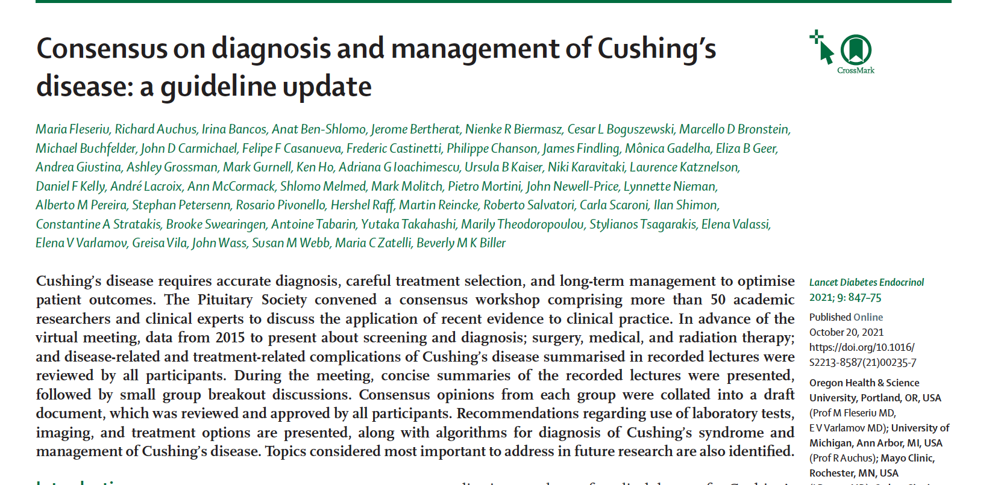
Consensus on diagnosis and management of Cushing’s disease: a guideline update

Slide 6
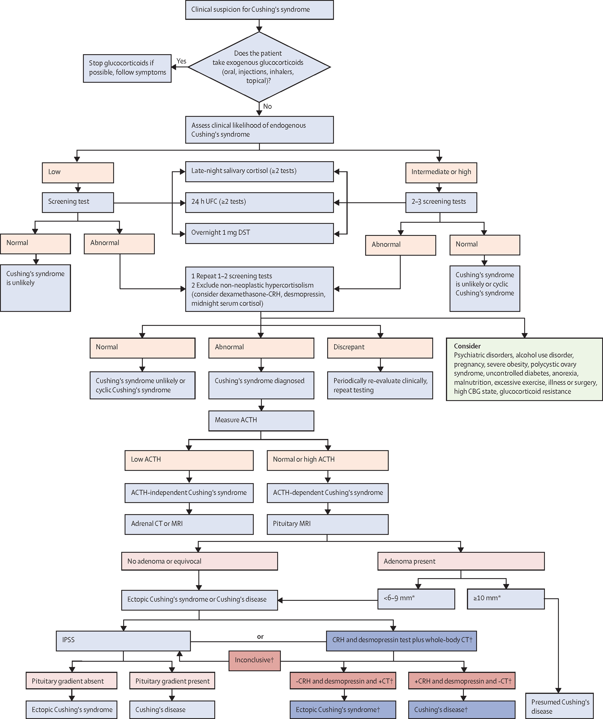
Algorithm for diagnosis of Cushing's syndrome

Slide 7
Algorithm for diagnosis of Cushing's syndrome
Still emphasizes UFC, late night salivary cortisol (LNSC) and dex test
Emphasis on multiple testing, especially LNSC
Decreased emphasis on Dex-CRH, Desmopressin test
Dex-test didn’t cite our paper of low sensitivity and specificity in those with mild Cushing’s
UFC random variation as high as 50%.
This is due to episodic nature of cortisol secretion.

Slide 8
Overnight dexamethasone test
0800 h cortisol (μg/dL)
Patient #

Slide 9
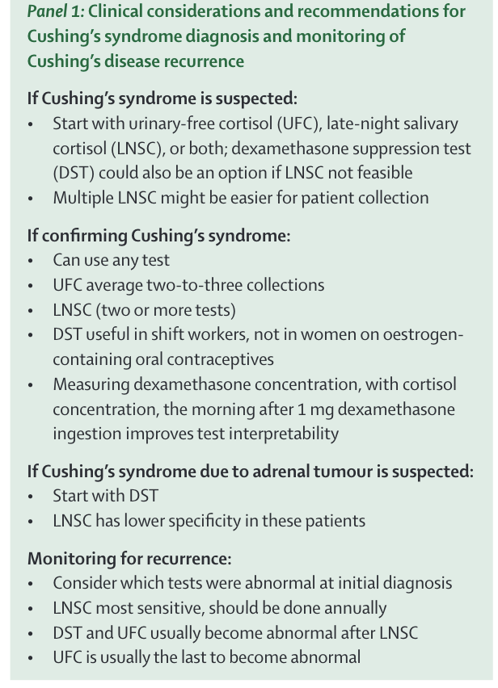
Clinical considerations and recommendations for
Cushing’s syndrome diagnosis and monitoring of
Cushing’s disease recurrence

Slide 10
Clinical considerations and recommendations for
Cushing’s syndrome diagnosis and monitoring of
Cushing’s disease recurrence
There is no single preferred diagnostic test for Cushing’s Syndrome, nor is there consensus on how to decide whether and when to test, despite attempts to develop a score for ease of diagnosis.
Clinical judgment and index of suspicion for Cushing’s syndrome are important and underscore the need to individualized decisions about timing and selection for diagnostic testing on the basis of the clinical scenario
Need multiple testing when patient is in a “high”

Slide 11
What is missing?
Medications Affecting Cortisol
Most Cushing’s have trouble sleeping, may have anxiety and depression
Most sleep medicines and some anxiety and depression medications affect cortisol
Unclear the effect, but likely to be significant
Unclear how long a patient needs to be off these medicines to give a true reading of cortisol secretion
Dr. Friedman recommends stopping at least one day before testing, but may need longer time

Slide 12
MEDICATIONS AND SUPPLEMENTS AFFECTING CORTISOL LEVELS
Bold indicates substantial effect.

Slide 13
MEDICATIONS AND SUPPLEMENTS AFFECTING CORTISOL LEVELS
Bold indicates substantial effect.

Slide 14
Episodic vs Cyclic vs Periodic vs Variable Cushing’s
Periodic and cyclical refer to changes in cortisol levels that occur on a regular predictable basis.
Cyclic -2 peaks and 1 trough
Episodic refers to high cortisol levels that are random.
Most of my patients are episodic.

Slide 15

Some studies suggested use of the term mild or episodic hypercortisolism on the basis of at least one physiological 24-h urinary free cortisol (UFC) measurement during repeated testing (Friedman references)
Notably, episodic excessive cortisol secretion and a high degree of day-to-day variability are general characteristics of endogenous hypercortisolism reported in Cushing’s disease
The absence of a uniform definition for cyclic Cushing’s syndrome and the common use of alternative terms impede precise reporting of cases and leave room for interpretation and potentially misinterpretation of results.
The two most widely accepted definitions of cyclic Cushing’s syndrome are based on either three hypercortisolaemic peaks in cortisol concentrations interspersed by two eucortisolaemic troughs or on two peaks separated by one trough, of which the latter also requires the resolution of clinical symptoms during eucortisolaemic phases.
In contrast, Sandouk and colleagues proposed to distinguish between variable hypercortisolism with non-variable clinical symptoms and “true” cyclic Cushing’s syndrome with variable symptoms.

Slide 16
Here today, gone tomorrow: a reappraisal of cyclic Cushing’s syndrome, M. Reincke SY60-02
I was recently at the Endocrine Society meeting and went to a session on cyclical Cushing's and tried to define it as having peaks and troughs.
They did mention that what I describe as episodic Cushing's can be called variable Cushing's and felt that it is fairly common.
Even cyclical Cushing's, they felt, occurs in 20% of cases.
They are going to do a registry of cyclical Cushing's to show that it is much more common than people think
I think most endocrinologists expect to do 1 test and, if that test is negative, they dismiss the patient as not having Cushing's.
My philosophy is to do multiple testing to dig deeply into whether a patient has Cushing's or not.

Slide 17
Episodic Cushing’s is common
Friedman, T.C., Ghods, D.E., Zachery, L., Shayesteh, N., Seasholtz, S., Zuckerbraun, E., Shahinian, H.K., Lee, M.L., McCutcheon, I.E. (2010) High Prevalence of Normal Tests Assessing Hypercortisolism in Subjects with Mild and Episodic Cushing’s Syndrome Suggests that the Paradigm for Diagnosis and Exclusion of Cushing’s Syndrome Requires Multiple Testing. Hormone and Metabolic Research. 42: 874-881.
We found that 65 of the 66 patients with Cushing’s syndrome had at least one normal test of cortisol status and most patients had several normal tests.
The probability of having Cushing’s syndrome when one test was negative was 92% for 2300 h salivary cortisol, 88% for 24-h UFC, 86% for 24-h 17OHS and 54% for night-time plasma cortisol.

Slide 18
Episodic Cushing’s is common
These results demonstrated that episodic hypercortisolism is highly prevalent in subjects with mild Cushing’s syndrome and no single test was effective in conclusively diagnosing or excluding the condition.
Rather, the paradigm for the diagnosis should be a careful history and physical examination and in those patients in whom mild Cushing’s syndrome/disease is strongly suspected, multiple tests assessing hypercortisolism should be performed on subsequent occasions, especially when the patient is experiencing signs and symptoms of short-term hypercortisolism.

Slide 19
Episodic Cushing’s is common
Our paper on episodic Cushing’s syndrome showed that most patients with confirmed Cushing’s syndrome are episodic with one or more normal values among high values.
Thus one normal value does not exclude Cushing’s.
A series of normal values does make Cushing’s unlikely at the current time

Slide 20
Episodic Cushing's: Conclusion
Data shows that all patients are episodic to some degree
May account for many patients incorrectly diagnosed as normal.
Marked by mostly normal (or low) cortisol levels with some high values accounting for the signs and symptoms of Cushing's syndrome
But lows interspersed with highs may make symptoms worse.
Can be all types of Cushing's syndrome, but in my hands, its pituitary.
Very difficult to diagnose and exclude

Slide 21
Episodic Cushing's Conclusions (3)
I agree with the Endocrine Society recommendations and like to see 2 different tests high.
The higher the test, the more likely Cushing's is
May limit the severity of the signs of hypercortisolism. (less weight gain)
Patients with mild/episodic Cushing's seem to have as many symptoms and as poor a quality of life as full-blown-may be due to daytime lows.

Slide 22
Episodic Cushing’s
My approach is to measure 3-8 UFCs and 17-OHS and 3-8 salivary cortisols in patients with a high degree of suspicion and symptoms of periodicity.
Multiple serum midnight cortisols
The patient should keep a diary of symptoms to correlate with cortisol values.
Patients should try to collect urines/saliva when high symptoms.
If all urines /saliva are normal, it makes active Cushing's syndrome unlikely at that time.
Patients should be followed and re-examined at a future time.

Slide 23
Surgery vs Medical Therapy
Medical treatment for Cushing’s disease has advanced in the last several years with many drugs to choose from.
Drugs can be used individually or in combination.
I have a lot of “tricks” to optimize medical treatment.
I have one patient on ketoconazole for 12 years and many on medicines for years without side effects.
Don’t have to worry about flying for surgery, insurance coverage, post-op issues

Slide 24
Preoperative Medical Therapy
Dr. Friedman has been advocating this for years
Can be used to determine how much of patient’s symptoms are due to high cortisol.
Can be used to get patients healthier prior to surgery.
I am now giving ketoconazole up to the day before surgery in all pre-op patients
Likely decreases the drop from high cortisol to normal cortisol post-op (cortisol withdrawal)
Downsize is that it may be harder to see a drop in cortisol post-op and determine a cure (but hard to tell in episodic patients anyways).
Discussing a multi-center trial with Recordati Pharmaceutics

Slide 25
Medical treatment for Cushing’s syndrome
*Ketoconazole-In my opinion, still the best
* Isturisa (osilodrostat), works will but increases cortisol precursors, same compound as Metyrapone
* Recorlev (Levoketoconazole)
*Korlym (RU486)-can get adrenal insufficiency and hard to monitor or correct adrenal insufficiency
*Cabergoline-sporadic
*Paseriotide-somatostatin analog-works poorly and gives diabetes
Aminoglutethimide- not sure if available
Mitotane-permanent adrenal insufficiency, hard to swallow
Trilostane- can be given IV
  * will discuss today

Slide 26
Cortisol synthesis
#
*
*
*
#
*
Keto *
Isturista #
*

Slide 27
Ketoconazole
Off-label use, not FDA approved for Cushing’s syndrome in the US (but approved in Europe).
Works by blocking several steps in cortisol biosynthesis.
May also inhibit pituitary cell growth
Has a pretty short half-life-6-8 hrs-I give it at night as Cushing’s disease is marked by high cortisol at night.
Side effect-elevation of liver tests, which is reversible on stopping drug.
Liver test abnormalities are more pronounced at higher doses-> 1200 mg.
Check liver tests at baseline and every 2-3 months
Thought to increase QT interval, but found not to be the case.

Slide 28
Ketoconazole
Cushing’s syndrome is a disease of high night time cortisol, some patients have low daytime cortisol.
  Give 200 mg 1 hr and 3 hr before bedtime to decrease night time cortisol
  Can go up on night-time dose
  Give 200 mg 3X/day-often lunch, dinner and bedtime
  Can go up on the dose for severe hypercortisolism
  I usually give patients some 5 mg pills of hydrocortisone to be taken in the AM, if symptoms of adrenal insufficiency (nausea, vomiting, diarrhea, abdominal pain, achy).
  Rarely do they need it, but it is good to have on hand
  I give every patients vitamin E 400 iU a day and milk thistle with 1000 mg of silymarin, to protect the liver.
  I only see increase in liver tests rarely with this pretreatment.

Slide 29
Ketoconazole drug interactions
Interacts with drugs, especially statins (but can be given with a lower dose of statin).
Instead of Lipitor 80 mg, replace with Lipitor 40 mg or Crestor 20 mg.
Benzodiazepines that are not metabolized by CYP450 3A4 (lorazepam, oxazepam, temazepam) may be substituted for Xanax (alprazolam) or Ambien (Zolpidem)
Dose of Elliquis (apixaban) should be reduced
Most interactions are theoretically (yes you can take it with Tylenol) and not clinically significant, but warnings are including due to the effects of ketoconazole on the liver.
Calcium may reduce the effects of ketoconazole so it should be given 2 hours apart
Concern about inhalers (Advair, Flonase, ProAir HFA) probably not important
Concern about drinking alcohol as that can affect the liver
Grapefruit juice may increase the blood levels of ketoconazole (probably not an issue as I use low doses of ketoconazole).

Slide 30
Ketoconazole
Works in almost all patients
Educate patients about adrenal insufficiency
Can be used to determine how much of patient’s symptoms are due to high cortisol.
Can be used to get patients healthier prior to surgery.
I am now giving it up to the day before surgery
May decrease the drop from high cortisol to normal cortisol post-op
I use it often before adrenalectomy (may decrease hyperplasia seen on pathology)
Monitor symptoms, UFC (not 17OHS) and serum cortisol and ACTH.
ACTH should go up, that means it is working
Higher ACTH nay confirm Cushing’s.
Can be used for years with monitoring of liver tests (LFTs) and pituitary tumor
Should be gold-standard to compare new drugs (but won’t)

Slide 31
Ketoconazole and testosterone
Lowers testosterone (good in women, may be bad in men)
I haven’t seen many problems with it in men,but could give testosterone back if needed.

Slide 32
Some Endocrinologists say Ketoconazole is a dangerous drug and should only be used in those with severe Cushing’s
Ketoconazole is safe, with the main side effect being increased liver tests, which usually occur at doses > 1000 mg/day and are reversible.
It does interact with a lot of drugs, but these interactions can usually be dealt with by changing the other drug or watching for side effects
It has a short-half life so it can be given at night, when cortisol is inappropriate high in Cushing’s patients.
I usually give 200 mg at 8 and 10 PM and have patients take 5 mg of hydrocortisone in the AM, if needed.

Slide 33
Some Endocrinologists say Ketoconazole should only be used in those with confirmed Cushing’s
Ketoconazole can be used diagnostically to determine which symptoms a patient has are due to high cortisol.
I use it in patients who Im pretty sure, but not completely sure has Cushing's and I want them to get symptomatic relief.
I’m concerned if someone doesn’t get better on ketoconazole, if they really have Cushing's.
I have kept patients on ketoconazole for up to 12 years without problems.
I often stop it for a round of testing, or if a patient develops a tumor on MRI.
Stop 2 weeks before testing.

Slide 34
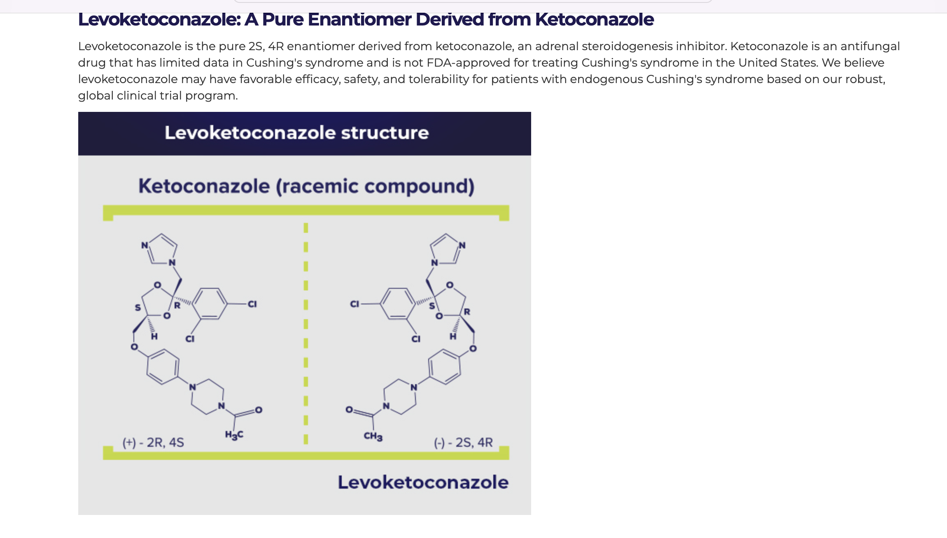
Levoketoconazole (Recorlev)
Xeris Pharmaceuticals
Enantiomer of ketoconazole (left hand)

Slide 35
Levoketoconazole (Recorlev)
Company claims that Levoketoconazole is substantially more potent in cortisol synthesis enzymes than its dextro ­isomer (dextroketoconazole)
Might allow a lower dose of levoketoconazole to achieve the same efficacy as currently utilized doses of racemic ketoconazole

Slide 36
Levoketoconazole (Recorlev)
Recorlev’s starting dose is 150 mg twice daily and should be taken orally with or without food. The maximum recommended dose is 1,200 mg per day, given as 600 mg twice daily.
Dr. Friedman believes ketoconazole should be given at night.
The most common side effects associated with Recorlev include nausea, vomiting, increased blood pressure, abnormally low blood potassium levels, fatigue, headache, abdominal pain, and unusual bleeding.

Slide 37
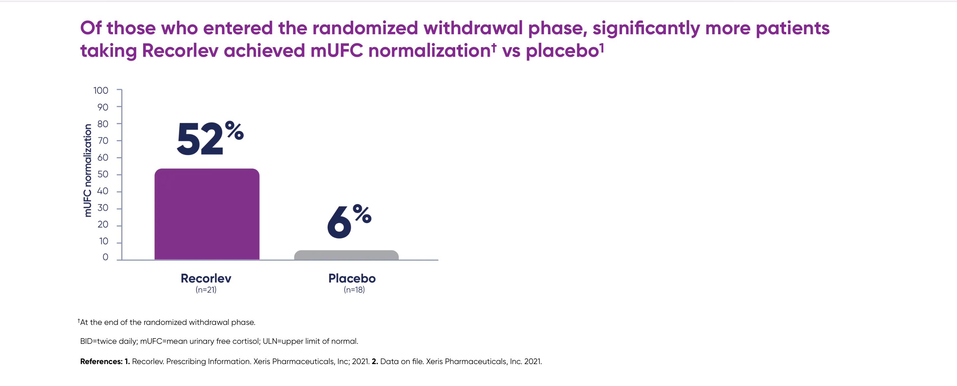
Levoketoconazole (Recorlev)

Slide 38
Levoketoconazole (Recorlev)
FDA approved
Has a support group Panther
Requires a preauth
May have less side effects than ketoconazole, but it hasn’t been tested
Expensive, so insurance companies may not cover it
I haven’t found a need to use over ketoconazole which is low cost and easy to obtain.

Slide 39
Isturisa (osilodrostat), works well but has a lot of side effects, same compound as Metyrapone
Isturisa blocks 11β-hydroxylase, like rarer type of congenital adrenal hyperplasia)
Same compound as Metyrapone
Get a build up of cortisol precursors (not with ketoconazole)
Can lead to high testosterone (extra facial hair, acne, hair loss, irregular periods)
Can lead to low potassium
Can lead to increased cortisol precursors (mineralocorticoids) that give hypertension
Can add ketoconazole back to lower testosterone/precursors
Most women should go on spironolactone

Slide 40
Cortisol synthesis
#
*
*
*
#
*
Keto *
Isturista #
*

Slide 41
Isturisa (osilodrostat), works well but has a lot of side effects, same compound as Metyrapone
Available in 1 mg, 5 mg, 10 mg dose
Dr. Friedman usually starts with 2 mg at bedtime, then goes up to 2 mg at 8 and 10 pm
Maximum dose is 15 mg
EKG at baseline and every year is recommended (but probably not needed).
Expensive, insurance companies may not approve it
Has support program called Anovo
My second choice

Slide 42
Isturisa plus ketoconazole
Can add ketoconazole back to lower testosterone/precursors
Still give both at night
Still watch for adrenal insufficiency (Isturisa can be potent)

Slide 43
Cabergoline
The D2-receptor agonist, cabergoline, at doses of 0.5–7 mg/week, leads to long-term biochemical remission in about 30% of patients.
Side effects include nausea, headache, and dizziness; cardiac valve fibrosis seen was not noted in doses given to patients with Cushing’s disease.
This treatment represents an off –label use of the drug.
I have one patient who took ketoconazole plus cabergoline for years, did well and got pregnant and named her daughter Theodora.

Slide 44
Korlym (Mifepristone)
Mifepristone is a glucocorticoid and progesterone receptor antagonist that can ameliorate the signs and symptoms of Cushing’s syndrome.
300-1200 mg per day (can not be given nightly)
Because it increases ACTH and cortisol concentrations in patients with Cushing’s disease, clinical cortisol-dependent variables (hyperglycemia and hypertension) need to be used to adjust the dose.
The absence of a measurable marker makes it hard to monitor.
Adverse events include symptoms of cortisol insufficiency (fatigue, nausea, vomiting, arthralgias, and headache), increased mineralocorticoid effects (hypertension, hypokalaemia, edema), and antiprogesterone effects (endometrial thickening, excess bleeding)
Recently FDA changed its label so it can be used with ketoconazole
Maybe the best drug for adrenal Cushing’s
My third choice.
Relacorilant, a more specific glucocorticoid receptor antagonist is now being studied and may be approved in 2024.

Slide 45
Pasireotide (Signafor)
Pasireotide is a somatostatin receptor ligand.
FDA-approved
A trial of 162 patients showed that subcutaneous pasireotide at a dose of 600 μg or 900 μg twice a day normalized UFC production in 15% of patients receiving the 600 μg dose and 26% of patients receiving the 900 μg dose.
Hyperglycemia occurred in 73% of patients.
92% had side effects
Dr. Friedman does not recommend it

Slide 46
Medications used to treat Cushing’s syndrome

Slide 47
So who gets surgery and who stays on medicines?
Side effects on medicine-especially liver function tests
Medicine no longer works, especially in combination
Patients wanting more definitive treatment and willing to take the risk that surgery may not work

Slide 48
Is Cushing’s rare-Catalyst study says no
ADA meeting 2024
Part one of the CATALYST study assesses the prevalence of hypercortisolism among adults with difficult-to-control type 2 diabetes.
Hypercortisolism was defined as having a dexamethasone suppression test 8 AM cortisol level > than 1.8 μg/dL and a dexamethasone level of more than 140 ng/dL.
Of the first 700 people to enroll, 24% had hypercortisolism.
25% of them had adrenal adenomas
Lower rate in Hispanics
These patients will be treated with Korlym or have a unilateral adrenalectomy.
Those who had a unilateral adrenalectomy had resolution of their diabetes.

Slide 49
Is Cushing’s rare-Catalyst study says no
Probably missed those with mild pituitary Cushing’s disease.
Pituitary patients often don’t suppress to dexamethasone and should be screened with nighttime salivary cortisol tests.
“These results are very powerful. While cortisol’s role in diabetes is well understood, most diabetes care providers have not considered hypercortisolism as a source of the disease for their patients with difficult-to-control diabetes,” Ralph DeFronzo, MD, chief of the diabetes division and professor of medicine

Slide 50
What does the future hold?
Most patients with Cushing’s Disease will be treated initially with medical therapy
Single or combination therapy will be used by Cushing’s experts
Medications will be used
  To see how much of the symptoms are due to hypercortisolism
  Get the patient ready for surgery
  Prevent the post-op cortisol drop
Medications will be used long-term
Those that breakthrough of have side effects will be offered surgery
Some patients may want to stay on the medications long-term vs surgery
Many patients with more borderline workups will be treated
The number of medications will expand

Slide 51
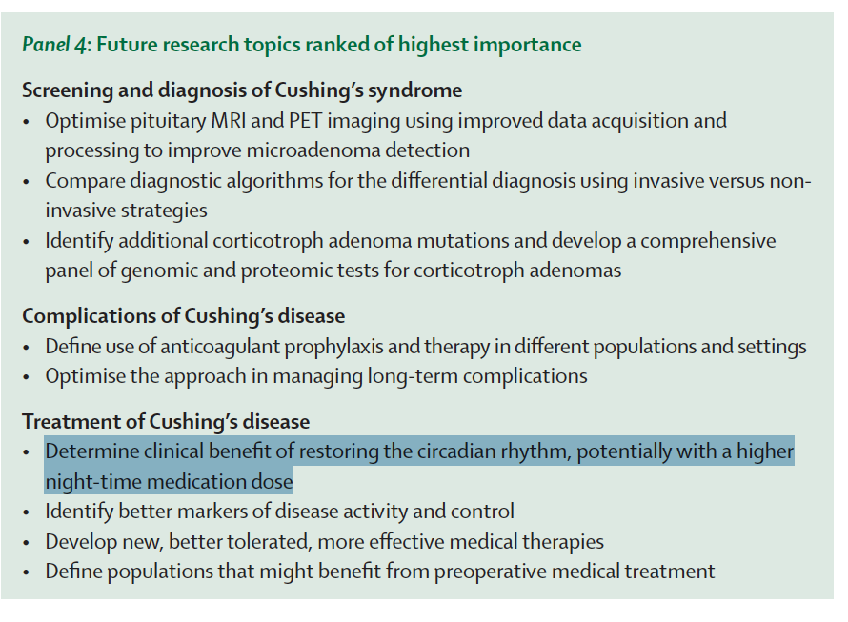
What does the future hold?
Most medicines to lower cortisol should be given at night
Dr. Friedman has been doing this for years.

Slide 52

CBS-The early show

Slide 53

Camille’s wedding

Slide 54
Who runs the best pituitary patient conference?
The Magic Foundation
Thanks to Dianne Kremidas for putting on a great conference

Slide 55
For more information/to schedule an appointment/ to listen again
Talk will be posted at www.goodhormonehealth.com in a few days
https://www.goodhormonehealth.com/webinars/
https://www.youtube.com/watch?v=wNMhKDxt3zU
https://www.facebook.com/goodhormonehealth/
Schedule an appointment on www.goodhormonehealth.com
Please email us at mail@goodhormonehealth.com
It will also be on Dr. Friedman’s podcast channel- available on spotify, apple podcasts, iheartradio, podcastidex, and amazon music

Slide 56
Questions?

