Slide 1


Theodore C. Friedman, M.D., Ph.D.
(the Wiz)
Professor of Medicine-UCLA
Chairman, Department of Internal Medicine
Charles R. Drew University
Dr. Friedman’s Endocrinology Clinic
Optimal Replacement for Hypopituitarism
Adult division of the 30th Annual Magic Foundation Convention
Chicago
July 12, 2024

Slide 2

Outline
Causes of Hypopituitarism
Cortisol, the right and wrong way to give
Thyroid optimization
Desiccated thyroid for central hypothyroidism
Growth hormone, not just for kids
Oxytocin-the love hormone
Testosterone, not just for men
Stimulants to treat pituitary apathy
Learn about the common medicine you should never take if on growth hormone
Learn how hormones interact

Slide 3
Pituitary Hormone Replacement
What’s the Big Deal?
Pituitary disorders are common, but experts in treating them are not!
Many patients with hypopituitarism feel like crap with weight gain and fatigue
Small changes in replacement may make a big improvement in symptoms
Many endocrinologists do not understand how to properly replace patients with hypopituitarism
  They do not understand (or don’t believe in) monitoring hormone levels
  Fine tuning makes a difference
  Extra’s (testosterone for women, oxytocin, stimulants) make a difference
We need to do more!

Slide 4

What’s the Big Deal, Doc? (cont.)
Patients with hypopituitarism that receive conventional therapy have increased mortality
  This is suggested - but not proven - to be due to GH deficiency (Rosen and Bengtsson, Lancet, 1990, 336:285; Bates, et al., JCEM, 1996, 81:1169)
The quality of life was seen to decrease in patients with hypopituitarism
  This may be due to suboptimum replacement
  of pituitary hormones

Slide 5
Hormonal Axes
Adrenal (corticotropes)=CRH-ACTH-Cortisol
Thyroid (thyrotropes)= TRH-TSH-T4/T3
Gonads (gonadotropes)= GnRH-LH/FSH-Testosterone/estrogen
GH (sommatotropes) =GHRH-GH-IGF1
Prolactin-sommatomamotropes
Posterior Pituitary-ADH, oxytocin

Slide 6
Order of Hormone Deficiencies
GH
Gonadotropins (FSH, LH)
TSH
ACTH
Prolactin
Posterior pituitary hormones

Slide 7
Causes of Hypopituitarism
Anywhere along the hypothalamic-stalk-pituitary axis
Microadenomas! (Yuen, et al. Clinical Endocrinology 69:292-298, 2008

Slide 8
Pituitary Causes of Hypopituitarism
Pituitary Tumor (macroadenomas vs. microadenomas)
Pituitary Surgery
Pituitary radiation
Sheehan’s syndrome/ Simmond’s syndrome pituitary apoplexy
Hypophysitis
Pituitary infiltration
Empty Sella
Malnutrition/critical illness
Head trauma

Slide 9
Stalk/Hypothalamic Causes of Hypopituitarism
Craniopharyngioma
CNS malignancy
Surgery/radiation
Head trauma/accidents
Infiltrative diseases (histiocytosis X, hemachromatosis, sarcoidosis)
Infection
Drugs (steroids, dopamine analogues, somatostatin analogues)

Slide 10
Microadenomas and hypopituitarism (Yuen et al, 2008)
38 patients with non-secreting pituitary microadenomas (mean tumor size 4.2 mm) and normal serum IGF-I levels were studied.
19 patients (50%) were found to be GH-deficient, and had higher body mass index (BMI) than those that passed the GHRH-arginine test and healthy controls.
19 patients (50%) had at least one other pituitary hormone deficit.
We concluded that a substantial number of patients with non-secreting pituitary microadenomas were GH-deficient despite normal serum IGF-I levels, and had at least one other pituitary hormone deficit, suggesting that non-secreting microadenomas may not be clinically harmless.

Slide 11
Microadenomas and hypopituitarism
Patients with low IGF-1 and a microadenomas are even more likely to be growth hormone deficient.
Many Endocrinologists test for hypopituitarism only if a patient has had prior surgery or radiation to their pituitary.
Many guidelines do not recommend testing for GH deficiency in patients with pituitary tumors
My approach is to measure pituitary hormones first in patients with symptoms of hypopituitarism and if it points to hypopituitarism, then get a pituitary MRI
If MRI shows a small pituitary or a tumor and IGF-1 is low, and the patient has symptoms of growth hormone deficiency, then do a growth hormone stimulation test

Slide 12
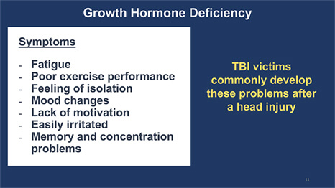
Traumatic Brain Injury

Slide 13
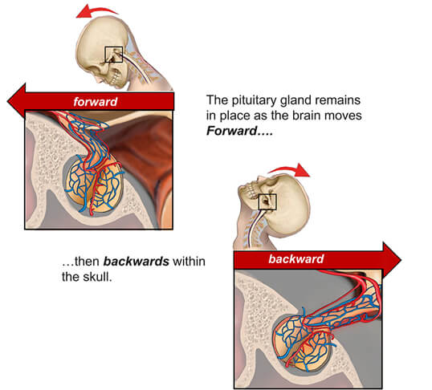
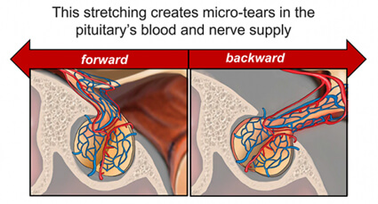
Traumatic Brain Injury

Slide 14
Sheehan’s syndrome
Sheehan's syndrome is post-partum pituitary injury due to massive hemorrhage.
Simmond's disease is atrophy or destruction of the anterior lobe of the pituitary gland resulting in hypopituitarism.
Traumatic injury resulting in hemorrhage in a non-pregnancy state can also cause partial or complete pituitary failure.
Dahan's syndrome is pituitary injury due to severe vasospasm, without significant hemorrhage.
Pituitary apoplexy is infarction of a pituitary adenoma and intra-mass hemorrhage with result injury to hormone production by the gland.

Slide 15
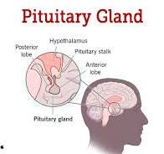
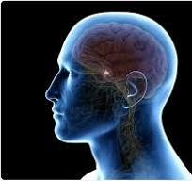
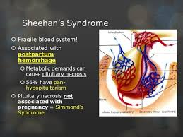
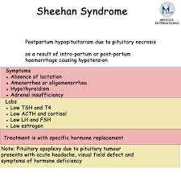
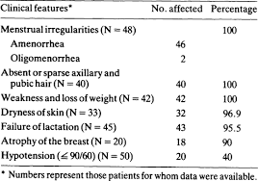
Sheehan’s syndrome

Slide 16
Sheehan’s syndrome
Severe headache
Hemorrhage
Can’t lactate
Adrenal insufficiency symptoms
May be delayed
May recover with time
Replace hormones as indicated

Slide 17
Glucocorticoid Insufficiency
Needs significant impairment of pituitary function
Classically, pituitary only affects cortisol, not mineralocorticoids (salt regulating hormones from the adrenals)
Can be life-threatening, but most patients do surprisingly well
Fatigue, lethargy, nausea, vomiting, joint pains, abdominal pain, weight loss, hypoglycemia (rare in adults), low sodium
I see a tetrad of GI effects: nausea, vomiting, diarrhea, abdominal pain

Slide 18
Glucocorticoid Insufficiency
Diagnosis
Screen with 8 AM cortisol
If < 3 μg/dL-clear glucocorticoid insufficiency
If > 10 μg/dL and not severe stress, glucocorticoid insufficiency unlikely
3-10 μg/dL-gray zone-do cosyntropin test (unless acute)
Stimulation tests need to be performed in a place that has expertise.

Slide 19
Standard (1 hr) Cosyntropin Test
250 mg of IV cosyntropin (ACTH₁₋₂₄)
Plasma cortisol at time 0, 30 and 60 minutes
  Any value over 16 mg/dL is normal
If peak response is less than 10 mg/dL, glucocorticoid replacement is required
If peak response is between 10 and 16 mg/dL
  Glucocorticoid replacement is recommended during stress,
  Otherwise, replacement needs to be individualized
Due to improvements in the cortisol assay, cortisol cutoff has decreased from 18 to 16.

Slide 20
ITT/ metyrapone Tests
Both can exacerbate glucocorticoid insufficiency
Both are non-physiological
Rarely needed
ITT requires physician supervision, but can also be used to diagnose GH deficiency
Patients often feel bad after metyrapone test
Alliance Rx, metopirone 30 mg/kg
Comes in 250 mg pills 11 pills
11-deoxycortisol at 8 am, give 50 mg of hydrocortisone after blood draw
Adrenal insufficiency is diagnosed if the 11-S level does not exceed 70 ng/mL and the cortisol level is <5 μg/dL

Slide 21

Daily Cortisol Production Rate In Man
Esteban et al. (JCEM, 72: 39, 1991) measured daily cortisol production rates in normal volunteers with a stable cortisol isotope method
  9.9 +/- 2.7 mg/day, 5.7 mg/m² day
Most, but not all of oral cortisol is absorbed
  Need to take 12-15 mg/day
True physiological replacement is likely to be benign
Cortisol secretion is highly regulated
  Stress, circadian rhythm-doubt we can do as well as mother nature
Most glucocorticoid replacement is supraphysiological
  Leads to osteoporosis, glucose intolerance and increased infections

Slide 22
Reminder
ACTH is the last hormone to be affected in pituitary insufficiency (GH, TSH, gonadotropins have to be invariably lost)
Symptoms of glucocorticoid insufficiency are unique (weight loss, nausea, abdominal pain)
Primary adrenal insufficiency is relatively rare and also has a unique symptom and lab complex.
Once started, glucocorticoids may be hard to stop and are often very detrimental.
Its probably a false-positive test, unless its in the right context.
Think twice before going on glucocorticoids.
Glucocorticoids stimulate mood, so the fact that you feel better on glucocorticoids does not mean you have adrenal insufficiency
Notes:
Is 20 an absolute or relative number to baseline cortisol value?
In secondary, adrenal atrophic b/c of low acth levels but can still respond to high dose acthbut not to low dose/physiiologic doses

Slide 23
Cortisol, the right and wrong way to give
Most patients are over-treated
Earliest manifestation of excess treatment is
  Easy bruisability
  Weight gain, central obesity, etc.
Earliest manifestation of inadequate treatment is joint pain or GI issues- nausea, vomiting, diarrhea, abdominal pain
GI issues exacerbate glucocorticoid absorption-vicious cycle
Reasonable to mimic circadian rhythm with most but not all cortisol, given first thing in the morning
Other studies suggest higher dose in AM, with lower doses throughout the day. Often 4 times a day
  May mimic cortisol secretion
Want to avoid large nighttime administration as it could lead to sleep disturbances
  But my study found patients need a bit of cortisol at bedtime to go into deep sleep

Slide 24
Cortisol, the right and wrong way to give (2)
No studies comparing different treatment regimens
My approach is to use hydrocortisone mainly in AM
Aim for dose between 15 and 20 mg/day in a woman
  Slightly higher in a man
Decrease dose slowly until some symptoms develop, then go back a dose
Small changes make a big difference, especially between 15 and 25 mg a day of hydrocortisone
Increase dose with illness
Short term: it’s better to err on giving more
Long term: it’s better to give less
Can take 2.5 or 5 mg more during heavy exercise

Slide 25
Adrenal Crisis-symptoms
GI issues (nausea, vomiting, abdominal pain, diarrhea)
Fatigue
High or low blood pressure
High pulse
Weak
Feel like passing out
Poor circulation

Slide 26
Glucocorticoid Replacement
(If Adrenal Crisis coming on)
Patients on lower doses of glucocorticoids more likely to have a crisis
  But they still do better long-term
Exacerbated by the flu, other illnesses
Less likely in hypopit patients than in those with adrenal disease
Know when its coming on
Double dose first, if still AI, 100 mg of IM hydrocortisone
Then Act-O-vial 100 mg solucortef plus syringe, available for IM injection
Lots of salt and fluids (Gatorade)
Florinef (synthetic aldosterone)
Lots of anti-nausea meds (zofran, phenergan), pain meds, anxiety meds (ativan) on hand
Do not be stoic - GO TO ER! (although may not be helpful, bring crisis letter
You may have to guide the ER doctor
High bp doesn’t exclude AI
Med-alert bracelet

Slide 27
Subcutaneous Cortisol
Useful in patients with gastro-intestinal issues that can’t absorb hydrocortisone
Uses solu-cortef in 100 mg Act-o-vial (reconstitute in 2 mL, so its 50 mg/mL)
Solu-cortef powder-can reconstitute in 1 mL so it is 100 mg/mL-may make it easier to calculate
Solu-cortef in 500 and 1000 mg vial may be available
Dose 3-4 times a day similar to oral HC
May be able to cut down the dose slightly
I am recommending patients to try subcutaneous cortisol before pumps

Slide 28
Monitoring Glucocorticoid Replacement
Signs and Symptoms
  24 hr urine for 17-hydroxysteroids (17-OHS)
  UFC tends to be high during replacement
In replacement, most of UFC excretion occurs right after taking the cortisol
  High doses are not bound to CBG
    Exceed reabsorption by the kidney
17-OHS (mg/day) reflects cortisol metabolism
  More integrated throughout the day
Other hormones affect glucocorticoid metabolism (discuss later)

Slide 29
Steroid coverage for illnesses or surgery
Moderate illness
  50 mg of hydrocortisone twice a day
Severe illnesses
  100 mg of IV hydrocortisone Q 8 hours
Minor procedures without anesthesia
  No extra coverage
Colonoscopy: double oral HC and fludrocortisone day before and day of procedure
Moderately stressful procedures (endoscopy or arteriography
  Single 100 mg IV dose of hydrocortisone prior to procedure
Major surgery
  100 mg of IV hydrocortisone before anesthesia and Q 8 hours
  Next day double your dose

Slide 30
Adrenal Fatigue-Fiction
Wildly proposed by alternative and anti-aging doctors
Lots of internet discussion on it, but may have die down
Often based on salivary cortisol assays (sometimes marketed directly to patients) that lack both precision and accuracy.
Theory is that “stress” leads the adrenals to work harder and make more cortisol, then it burns out (peters out) and makes less cortisol
“It’s like a hormone factory and it wanes in its production, one of the way it wanes is just by stress.”-Dr. Tori Hudson-Naturopathic Physician.
Alternative doctors may give herbs and supplements to stimulate the adrenal gland, but also give Isocort (used to be ground up sheep adrenals, now supplements) or hydrocortisone.
“Eat lean, green and clean”-one alternative doctor said is the treatment for adrenal fatigue
Notes:
Is 20 an absolute or relative number to baseline cortisol value?
In secondary, adrenal atrophic b/c of low acth levels but can still respond to high dose acthbut not to low dose/physiiologic doses

Slide 31
Adrenal Fatigue-Fact
The adrenals are up-regulated during stress and make cortisol, not less cortisol.
Mommersteeg et al. [Psychoneuroendocrinology (2006) 31, 216–225] studied 74 clinically diagnosed burnout individuals mostly on sick-leave and compared with 35 healthy controls.
They found similar salivary cortisol after awakening and at different times of the day and after an overnight dexamethasone suppression test in the 2 groups.
Patients should not be put on cortisol unless they are shown to be adrenally insufficient.
Notes:
Is 20 an absolute or relative number to baseline cortisol value?
In secondary, adrenal atrophic b/c of low acth levels but can still respond to high dose acthbut not to low dose/physiiologic doses

Slide 32
Central Hypothyroidism
Common, even with small tumors
Mild cases may be more manifest clinically
  More than “subclinical hypothyroidism” due to actual low thyroid hormones in central hypothyroidism
Similar signs/symptoms as in primary hypothyroidism
Low free T4 in the face of lowish TSH
In mild cases, free T4 between 0.7 and 1.0 ng/dL
Free T3 usually not helpful, although can be low as growth hormone helps convert T4 to T3
Usually based on baseline free T4 and TSH

Slide 33
Central Hypothyroidism-Treatment
Many options for thyroid hormone replacement.
L-T4 alone (Levothyroxine, Synthroid, Levoxyl, Tirosint, Unithroid)
L-T4 gel capsules-Tirosint, generic Tirosint, Thyquidity
L-T3 (Cytomel, liothyronine) alone
L-T4/L-T3 combinations
Desiccated thyroid (Adthyza, Armour, NatureThroid, WP thyroid, Erfa)-from pig thyroid. Often called Natural Desiccated Thyroid (NDT) or Desiccated Thyroid Extract (DTE)
Thyrogold-New Zealand cows
Desiccated thyroid/L-T4 combinations
Proper treatment needs to be individualized (not one blood pressure medicine).
Multiple studies have shown poor quality of life among patients on L-T4 replacement alone
Both WP thyroid and NatureThroid (made by RLC labs) have been on backorder for 4 years and unlikely to return.

Slide 34
Central Hypothyroidism
Treatment
L-thyroxine can be given
Most patients with central hypothyroidism do better on T4/T3 or T4/desiccated combinations
GH deficiency can lead to impaired T4 to T3 conversion
  T4/T3 or desiccated thyroid may be especially beneficial in central hypothyroidism
Treating with GH can decrease FT4 levels and unmask central hypothyroidism
  Recommended to treat both borderline central hypothyroidism and GH deficiency
Monitor by aiming for free T4 in upper-normal range (1.5-1.7 ng/dL).
TSH will be suppressed and is usually not worth measuring after starting treatment.
Patients with both primary hypothyroidism and a central component should also be monitored with free T4 and not TSH measurements.

Slide 35
Central Hypothyroidism-Treatment-Desiccated Thyroid
Armour thyroid is made by Abbvie and concern about variability of preparations and lack of standardization are unfounded.
NP thyroid is a brand of desiccated thyroid with minimal binders and fillers
Adthyza is a newer product that tests each lot for potency
Desiccated thyroid has a higher T3/T4 ratio than the human thyroid. Most patients on desiccated thyroid alone have high fT3, lowish fT4 and low TSH
Dr. Friedman sees less of a low on NP thyroid or Adthyza, than Armour
L-T3 has a short half-life and L-T3 or desiccated thyroid should be given twice a day
There may be other components of thyroid missing in synthetic preparations.
I usually give desiccated thyroid in a twice a day dose, especially in patients with a poor quality of life on L-T4 alone.
For hypopit patients, I aim for a fT4 and fT3 in upper normal range, with a suppressed TSH.

Slide 36
Hypothyroidism Treatment-Desiccated Thyroid- JCEM article
In the May 2013 issue of Journal of Clinical Endocrinology and Metabolism http://www.ncbi.nlm.nih.gov/pubmed/23539727, Huang and colleagues from the Walter Reed Medical National Military Medical Center in Bethesda, Maryland published the results of a randomized crossover study in which 70 patients completed the study and received either desiccated thyroid or levothyroxine replacement.

Slide 37
Hypothyroidism Treatment-Desiccated Thyroid- JCEM article
Patients were on a stable dose of levothyroxine and had a normal TSH before the study started.
78 patients were randomized and 70 concluding the study, with 35 received Armour Thyroid at the beginning and 35 received levothyroxine at the beginning.
The dose of either the levothyroxine or the Armour Thyroid was adjusted after six weeks so that the TSH was between 0.5 and 3.0.
They continued on that dose for an additional 10 weeks.
After 16 weeks, patients were switched over to the other compound with the same adjustment at 6 weeks and continued for another 10 weeks.

Slide 38
Hypothyroidism Treatment-Desiccated Thyroid- JCEM article
There was not a statistical improvement in symptoms for general health questionnaires or neuropsychological testing, however there was a trend toward improvement in these tests for the group that took the desiccated thyroid compared to the levothyroxine replacement group.
There was a 2.9 pound weight loss among the group that took the desiccated thyroid compared to the levothyroxine group that was significant.
Patients on Armour Thyroid did have a slightly lower HDL level that is the good cholesterol, so that could be a potential detriment to Armour replacement.
Both total T4 and free T4 were much lower on the Armour Thyroid than on levothyroxine replacement indicating that patients on Armour Thyroid need an additional low dose of levothyroxine, as Dr. Friedman often prescribes.
rT3 was higher in the levothyroxine replacement group, which may be detrimental

Slide 39
Hypothyroidism Treatment-Desiccated Thyroid- JCEM article
Most importantly, 49% of the patients preferred Armour Thyroid, 19% preferred levothyroxine and 33% did not notice a difference.
This was important as the study was blinded and they didn’t know which thyroid preparation they were taking and indicates some subtle improvement in how they were feeling with Armour Thyroid.
The subgroup that preferred Armour Thyroid lost even more weight; they lost 4 pounds on Armour Thyroid compared to levothyroxine.
They had better well-being and their thyroid symptoms were significantly better with better cognitive function on Armour Thyroid compared to when they were on levothyroxine.
This suggests that a subset of patients need Armour Thyroid as opposed to levothyroxine alone.
These patients may be poor converters of T4 to T3.

Slide 40
Hypothyroidism Treatment-Desiccated Thyroid- JCEM article
There were no side effects in the Armour Thyroid group; specifically, there was no increase in heart rate or pulse.
The authors concluded that improvement with Armour Thyroid may not be detected by the relatively insensitive methods used in the study.
They also concluded that once-daily desiccated thyroid in place of levothyroxine caused modest weight loss and possible improvements in symptoms and mental health without appreciable adverse effects.

Slide 41
Hypothyroidism Treatment-Desiccated Thyroid- my comments
I found it to be a very well designed and well executed study done by a reputable group and published in a superb journal.
I note that the Armour Thyroid was given as a single dose once a day without levothyroxine. Since Armour Thyroid contains T3 that has a short half-life, I prescribe Armour Thyroid twice a day.
I suspect that if the study gave Armour Thyroid twice a day, those patients would have done even better than on once a day Armour Thyroid.
This study clearly refuted that Armour Thyroid is inferior to levothyroxine.

Slide 42
Hypothyroidism Treatment-Desiccated Thyroid- my comments
The study also pointed out the importance of trying to determine the subset of patients to put on desiccated thyroid.
A significant subset of patients did prefer the desiccated thyroid.
Those who preferred desiccated thyroid were more likely to have autoimmune thyroid disease and had a slightly higher reverse T3, although neither of these were significant.

Slide 43
Hypothyroidism Treatment-Desiccated Thyroid- my comments
The study examined all patients with hypothyroidism on levothyroxine replacement, most of whom were doing well.
If the study used the subset of patients who were on levothyroxine replacement and feeling poor, I surmises that they would have done even better on desiccated thyroid.
Many of the patients who come to see me have a low quality-of-life on levothyroxine replacement.

Slide 44
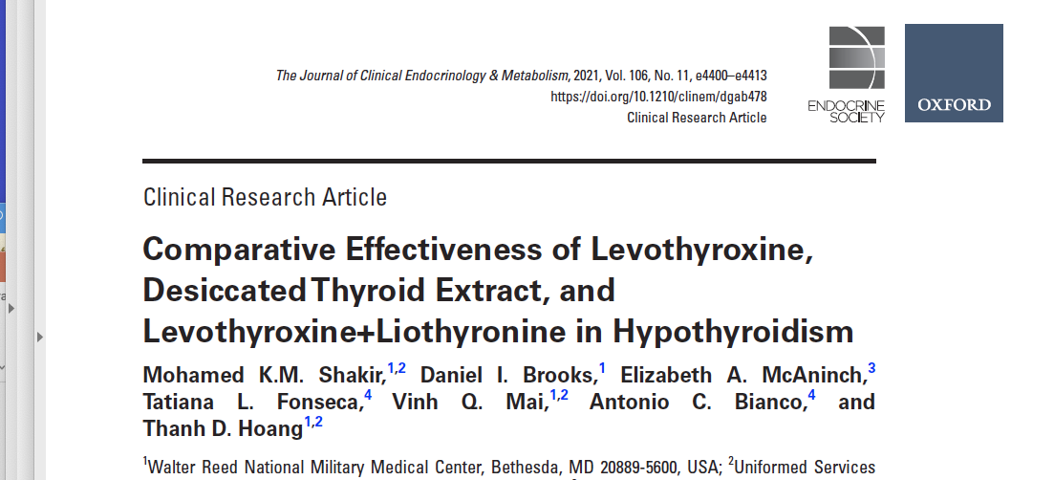
Shakir 2022 JCEM

Slide 45
Methods
This was a prospective, randomized, crossover study.
75 subjects completed the study.
There were 3 arms: DTE, LT4+T3 combination, and LT4
alone and blinded as to treatment.
Each subject was randomly allocated to one of these 3 arms for 12 weeks and then crossed over.

Slide 46
Results
Overall, 45% of patients indicated they preferred desiccated thyroid as their first choice of treatment, 32% preferred LT4/T3 as their first choice, and 23% preferred LT4 alone.
There was no significant difference between the 3 arms on the thyroid symptom questionnaire (p=.32).
For the secondary endpoints of weight, general health, depression (assessed using the Beck Depression Inventory), memory (Wechsler Memory Scale), lipids, and thyroid function, again, there were no significant differences between groups in any of the measures.
Polymorphisms did not affect outcomes

Slide 47
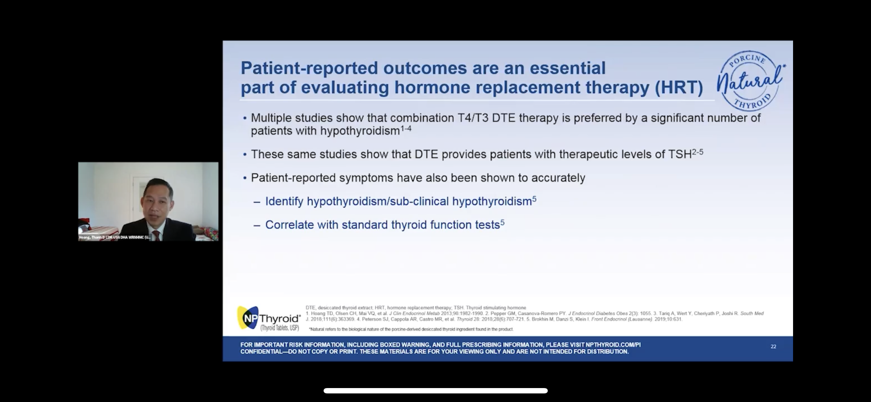
Hoang gave a Product talk at the 2021 Endocrine Society
Sponsored by Acella
Well-attended
Advocated for once a day desiccated thyroid use
Advocated for monitoring TSH
Mentioned several other articles showing increased patient satisfaction on desiccated thyroid.

Slide 48
Hoang’s comments
Subgroup analysis based on the scores of symptom questionnaires, they found that symptomatic patients on LT4 improved while being treated with LT4/T3 or desiccated thyroid
Reports of improvements in switching to desiccated thyroid were notable, Hoang added. "Many patients when switched from LT4 to desiccated thyroid extract said they felt much better, [with] more energy, less mental fogginess, a better outlook, less flair of lupus symptoms, easier to lose weight, etc."

Slide 49
Dr. Friedman’s comments
Advantage of the study is that it was blinded.
Small number of participants, but clearly desiccated thyroid was more preferred with a low number preferring L-T4 alone.
Didn’t pick patients specifically with hypothyroid symptoms.
Probably those with hypothyroid symptoms will likely have more pronounced improvement.
Desiccated thyroid should be given twice a day, this was only once a day.
Huang gives desiccated thyroid to have a normal TSH, Dr. Friedman aims for a normal to high freeT4 and freeT3 and can have a suppressed TSH.

Slide 50
Central Hypothyroidism-L-T4/L-T3 treatment
In general, take thyroid medicine first thing in AM on an empty stomach
If on twice a day treatment, take 2nd dose in mid- afternoon
Avoid taking with
Iron
Calcium
Vitamins with iron or calcium
Proton pump inhibitors, carafate, oral bisphosponates (Fosamax), orlistat, cholestyramine
Minor effect of soy

Slide 51
Central Hypothyroidism-selenium
Selenium increases T4 to T3 conversion and reduces TPO antibody levels.
Patients with untreated GH deficiency have decreased T4 to T3 conversion, so they are likely to benefit from selenium (but also benefit from GH treatment)
Selenium appears to increase the rate of diabetes.
I am cautious about giving selenium in those patients with prediabetes or diabetes or those with a family history of diabetes.

Slide 52
Growth hormone, not just for kids
There are more than 50,000 adults with a growth hormone (GH) deficiency diagnosis in the United States.

Slide 53
Growth Hormone Deficiency
Patients with hypopituitarism have increased mortality, suggested, but not proven to be due to GH deficiency
Growth hormone deficiency in adults results in:
  Decreased bone formation
  Increased fat mass (central obesity)
  Decreased muscle mass
  Lipid abnormalities
  Increased thickness of blood vessels
  Increased inflammatory markers
  Impaired quality of life
  Increased number of sick days
  Impaired exercise tolerance
Most abnormalities are corrected by treatment

Slide 54
Growth Hormone Deficiency
If left undiagnosed, AGHD may lead to increased risk for premature mortality, significant morbidity, and multiple signs and symptoms, including
An increase in body fat
A decrease in muscle mass
Weakness and fatigue
Osteoporosis
An increased rate of fractures
Dyslipidemia
Cardiovascular disease
Impaired psychological well-being such as isolation, anxiety, or depression

Slide 55
Growth Hormone Deficiency

Slide 56
Growth Hormone Deficiency-Diagnosis
Growth hormone is pulsatile, so a random growth hormone is not helpful.
You could be at the top of the pulse or the bottom of the pulse

Slide 57
Growth Hormone Deficiency-Diagnosis
Screen with IGF-I:
  If in top 50% of normal range for age and sex (> 150 ng/mL) GH deficiency less likely
  If empty sella, history of head trauma, headache and low blood pressure after delivery (Sheehan’s syndrome), history of pituitary surgery or radiation or pituitary tumor (micro or macro adenoma)=GH deficiency more likely
  If < 75 ng/mL-GH deficiency likely
  If in the lower 25%, worth testing with a stimulation test
Stimulation testing
  Glucagon stimulation test is preferred- GH deficient if GH is < 3 ng/mL ITT- GH deficient if GH is < 5 ng/mL
  Don’t agree with cutoff of 1 ng/mL in those with obesity
  Macrilen Stimulation Test

Slide 58
IGF-1 is only a screening test

Slide 59
Current AGHD Testing

Slide 60
Glucagon and Macrilen Stimulation Tests
Dr. Friedman uses the glucagon test, as approval for Macrilen is hard to obtain.
Offered both Tuesday night and some Sunday afternoons
Many other centers have stopped offering GH stimulation tests
New patients can have your appointment and stim test on the same Tuesday night.
You need to fast for 8 hrs

Slide 61
Mild Growth Hormone Deficiency Versus Mild Cortisol Deficiency - Which One Should You Treat?
 | Mild Growth Hormone Deficiency | Mild Cortisol Deficiency
Benefits of treating | Helps with symptoms including fatigue, poor sleep, joint pain, psychological issues | May prevent adrenal crisis
 | Helps with bone density, body composition, carotid intimal thickness, cardiovascular markers, lipids | May help with fatigue, joint pain, abdominal pain, nausea, diarrhea
Risks of treating | Easy to taper off or stop | Shuts down the adrenal glands from making its own cortisol, making it hard to taper off or stop
 | Joint pain and swelling | Weight gain, diabetes, infections, and osteoporosis
 | Theoretical risk of increased cancers and diabetes
 | Expensive and covered by insurance | Inexpensive and covered by insurance

Slide 62
Adult Growth Hormone Treatment-My Approach
Don’t need to adjust for body weight in adults.
Oral, but not transdermal estrogens inhibit the action of GH at the liver, leading to higher GH and lower IGF-I levels (Wolthers et al, AJP-Endo, 2001, 281:E1191).
Women need higher doses than men.
Start at 0.4 mg/day in women, 0.2 mg/day in men.
Give at night
Final dose varies widely and can not be predicted.
Titrate upwards with IGF-I measurements every 1-3 months.
Aim for IGF-I in upper 1/3 of normal range for age and gender (200-300 ng/mL).
May not see an improvement in symptoms until in this range.

Slide 63
Oral Estrogen/birth control pills
In women with growth hormone deficiency, avoid it!

Slide 64
Treatment of Growth Hormone Deficiency
Growth hormone if covered by insurance
Severe shortages
Cash pay for growth hormone
  Zomacton $100 for 5 mg (if dose is 0.4 mg, will last 12 days)=$250/month
  University Compounding Pharmacy
  Ocean Breeze Pharmacy
Amino acid blends
O-tropin (Orenda)-restores the pituitary, delivered by liposomes
$48/month
Serovital (amino acids), serovital.com or Costco ($94 for 40 day supply)

Slide 65
Long-Acting Growth Hormone Analogues
In August 2020, once-weekly Somapacitan (Sogroya®, Novo Nordisk A/S, Denmark) was approved by the FDA for treatment of adult GHD
In April 2023, Novo Nordisk made Sogroya available for patients with dult GHD
Somapacitan is a long-acting human GH derivative to which a small noncovalent albumin-binding moiety is attached to facilitate reversible binding to endogenous albumin, delaying its elimination, and thereby extending its duration of action with little to no accumulation of the drug when administered once-weekly.

Slide 66

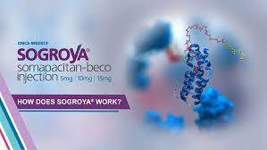
Long-Acting Growth Hormone Analogues
In a Phase 3, 26-week randomized, controlled multi-center study of 92 adults with GHD treated with Somapacitan or daily Norditropin, Somapacitan was well-tolerated, IGF-I standard deviation scores remained in the therapeutic range, and patients preferred the weekly Somapacitan therapy.
With the shortage of daily GH, Sogroya is an excellent option.
Dr. Friedman converts the daily dose X 7=weekly dose.

Slide 67
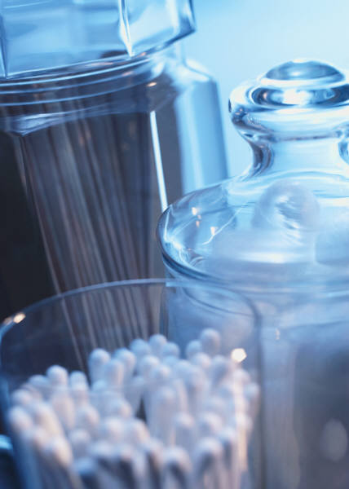
Diabetes Insipidus (now called Arginine Vasopressin Deficiency)
Defect in ADH
  Also called AVP
  Posterior pituitary
Excessive urination and thirst
Mild cases are probably common and worthy of treatment
Chronic polyuria may lead to bladder/kidney problems
How many times are you waking up at night?

Slide 68
Diabetes Insipidus (2)
I screen by having the patient collect urine for 24 hours and measure the volume.
Greater than 3 L indicates diabetes insipidus is likely
I confirm with a 12 hour fast (no water!) and collect an 8 AM serum and urine osmolality.
DI-High serum osmolality (>300 mOsm/kg), low urine osmolality (<600 mOsm/kg) and low AVP < 1 pg/mL).
Most patients have a low AVP level
Must avoid all fluid and food
Formal water deprivation test probably not needed.

Slide 69
Diabetes Insipidus
(cont.)
DDAVP pills probably the best
  nasal puffs (does work faster, but are more eraratic)
Take most of the dose at night to prevent waking up at night
Should have a period of “break-through” urination, usually in the evening.
Treatment is pretty benign
AVP may have other benefits

Slide 70
Oxytocin: the love hormone
Oxytocin is made by the posterior pituitary like AVP.
Only prominent pituitary hormone not tested or replaced
May have a role in bonding, intimacy, orgasm, GI issues, trust, generosity, pain and energy
Assay for 24 hr urine oxytocin commercially available at Meridian Valley Labs
No information of reliability of assay

Slide 71
Oxytocin
Oxytocin is available from University Compounding Pharmacy (and others) as sublingual troches or nasal spray.
Many patients have an improvement in symptoms with it
Some weight loss, less joint pain
More bonding, decreased social isolation (discussed in the lifestyle medicine talk)
May cause an increase in cortisol requirements
Contact us (established patients only) if you want to to be prescribed oxytocin.

Slide 72
Abnormalities Of Gonadotropes (women)
Gonadal Axis
  GnRH-LH/FSH -Testosterone/estrogen/progesterone
Lack of ovulation
Irregular or no periods
Hot flashes
Poor sleep
Infertility
Vaginal dryness
Osteoporosis
Decreased libido
Poor sense of well-being

Slide 73
What To Do If You Have Gonadotropin Dysfunction?
If trying to get pregnant
  Determine ovulation
  Get an anti-mullerian hormone (AMH level), high is good
  See reproductive endocrinologist
If not trying to get pregnant
  Replace estrogen
  Progesterone if a uterus (and sometimes without
  a uterus
  Testosterone if low libido and decreased muscle strength

Slide 74
Estrogen Replacement in Women
Amenorrhea or oligomenorrhea indicates gonadotropin deficiency
Irregular periods may be early sign of pituitary dysfunction
Previous WHI and HERS studies on post-menopausal women were not on estrogen
  Average age in WHI: 63
Younger hypogonadal women likely to benefit from estrogen replacement
Young women ‘feel better” on higher estrogen preparations
  May require higher doses than post-menopausal women
  Less clear for older women
Replacement and decision to have periods or not based on patient preference and age

Slide 75
Estrogen Replacement in Women
(cont.)
Choices include
  Premarin (pregnant mare urine, “conjugated estrogen”, multiple estrogenic compounds)
  Oral estrogen compounds (estrace)
  Birth control pills
    Contain relatively high doses progesterone and lower doses estrogen
  Estrogen patches (Climara, Vivelle)
  Estrogen creams (Estrogel)
  Vaginal estrogen (Fem-ring, Estring)
  Compounded Estrogen (creams, sublingual drops, pills)

Slide 76
Oral Estrogen Replacement,
But Not Other Routes
First pass effect in the liver
Blocks the action of GH at the liver to raise IGF-1
  Leads to high GH and low IGF-1 (both bad)
Raises sex hormone binding globulin (SHBG)
Raises total testosterone, but decreases free testosterone
  Low free testosterone may lead to decreased libido (and maybe low energy, decreased muscle mass)
Studies show that effects of oral estrogens (including birth control pills) decrease free testosterone levels for at least a year after discontinuing

Slide 77
Oral Estrogen Replacement,
But Not Other Routes (2)
Raises thyroid-binding globulin (TBG)
  Can lead to an increase in thyroid hormone requirements
Raises cortisol-binding globulin (CBG)
  Leads to high levels of total cortisol
  Makes testing for adrenal insufficiency difficult

Slide 78
Reminder, the common medicine you should never take if on growth hormone
Oral Estrogen/birth control pills
In women with growth hormone deficiency, avoid it!

Slide 79
What Type of Estrogen is Best?
Ovaries make estrone (E1), estradiol (E2), estriol (E3)
Estradiol is most abundant (“bioidentical”)
Slight evidence that estrone is detrimental (breast cancer) and estriol is good
Oral estrogens get converted to estrone
I use mainly estradiol patch (Vivelle dot patch) or Estrogel
Titrate dose so that estradiol is in the upper normal range for the follicular period (50-100 pg/mL)
Some compounding pharmacies encourage bi-est (estradiol/ estriol) or tri-est (estrone/ estradiol/ estriol)-not much of an advantage
Young hypopit patients should take a higher dose of estrogen

Slide 80
Should You Take Estrogen/Progesterone to Induce A Period?
Taking 5-10 mg of Provera (synthetic Progestin) or 100-200 mg of Prometrium (progesterone “bioidentical”) for 10 days, then stopping, will usually induce a period
Taking 2.5 mg of Provera or 100 mg of Prometrium daily will usually not induce a period
I tend to have women less than 40-45 have a monthly period, older than that not to have a period
Women with an intake uterus should take a progesterone and sometimes women without a uterus
  Progesterone may help with sleep, hot flashes, but could give fatigue and bloating, but unlikely with progesterone/prometrium.

Slide 81
Testosterone, not just for men

Slide 82
The Physiologic Role Of Testosterone In Women Remains Poorly Understood
Previous studies of testosterone supplementation,
largely in surgically or naturally menopausal
women, have reported improvements in
  subjective measures of sexual function
  sense of well being
  variable changes in markers of bone formation and resorption

Slide 83

Potential Benefits of Androgen Supplementation in Women
Improved sexual function
Improved bone mineral density
Improved muscle mass and function
Improved mood and sense of well-being
Improved cognitive function
Amelioration of autoimmune disease
Amelioration of premenstrual syndrome
Improvement in dry eye syndrome

Slide 84
Potential Adverse Effects Associated with Testosterone Supplementation
The potential risks of testosterone administration to women include
  virilization
  hirsutism
  acne
  effects on plasma lipids
  effects on behavior

Slide 85
Testosterone in Women with Hypopituitarism
A prior study demonstrated that patients with hypopituitarism have increased mortality
  mainly due to cardiovascular, respiratory, and cerebrovascular events
Hypopituitarism in women is associated with a number of symptoms, including
  Obesity
  Poor quality of life
  Decreased libido
  Osteopenia
These persist in spite of standard hormonal replacement

Slide 86
Severe Androgen Deficiency in Women with Hypopituitarism
Women with hypopituitarism
  Have impairment of both the adrenal and ovarian sources of androgen production
  Have lower T and DHEAS levels than women with ovarian failure alone
  Ref Miller et al., J Clin Endocrinol Metab 2001;86:561-7.

Slide 87
Treatment of Androgen Deficiency in Women with Hypopituitarism
I recommend measuring bioavailable and total testosterone in women with hypopituitarism
If bioavailable testosterone is < 2 ng/dL, I recommend testosterone cream from a compounding pharmacy
In younger women, I use 2.5 mg/mL, 1 mL daily
In older women, I use 1.25 mg/mL, 1 mL daily
Watch out for facial hair or acne or hair loss, but usually works well
Subcut shots are possible but tricky as the dose has to be very low
Aim for a bioavailable testosterone 3-7 ng/dL

Slide 88
DHEA in Women with Hypopituitarism
Measure DHEAS, give DHEA
Adrenal androgen, often low in hypopituitarism.
DHEA dose 10-25 mg may help with energy
Side effects are oily skin and greasy hair
I find testosterone usually more helpful than DHEA

Slide 89
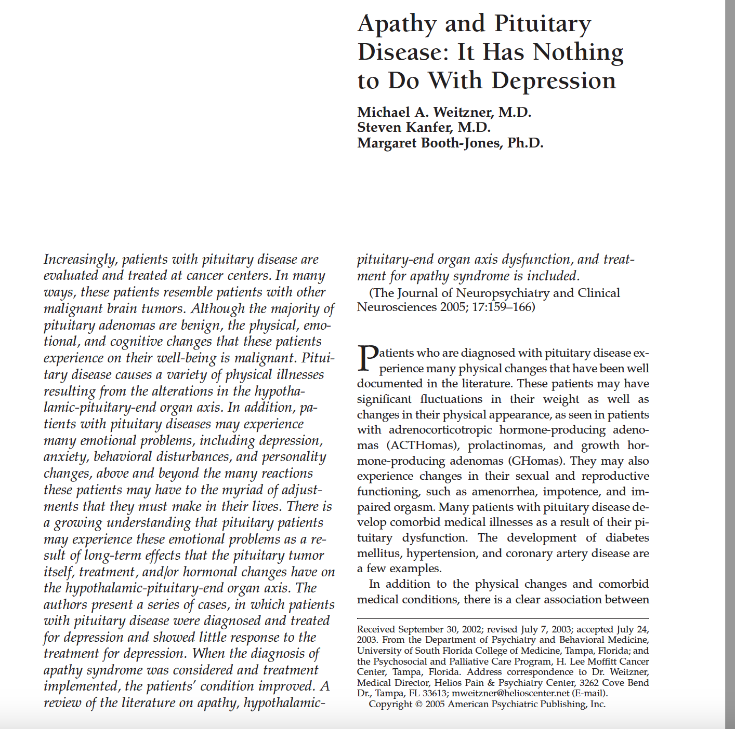
Stimulants to treat pituitary apathy

Slide 90
Apathetic Depression in Hypopituitarism
Apathy-no interest in life’s pleasures
Most hypopit patients have this
Football players with multiple concussions (Junior Seau?)
Responds to stimulants, not antidepressants
Dr. Friedman likes Ritalin LA 20 mg in AM
Helps with energy, focus, weight loss, ideal medicine
Side effects include hyper, insomnia, anxiety
Most hypopit patients should be on a stimulant
Works well with growth hormone and oxytocin

Slide 91
Hormonal Interactions
Treating a patient with adrenal insufficiency and hypothyroidism with thyroid hormone
  Increases the breakdown of cortisol
  May lead to an adrenal crisis
Thyroid hormone may also
  increase catabolism of other hormones (GH, testosterone)
  lead to increased requirements when thyroid dose is increased
Treating with GH may increase T4 to T3 conversion
  Dose of T3 (if on T3) may need to be reduced
GH may decrease TSH
  Treating with GH may unmask or exacerbate central hypothyroidism
  May need a higher dose of thyroid hormone once GH treatment is started

Slide 92
Hormonal Interactions (2)
Oral, but not transdermal estrogens, increase the need for L-thyroxine in women with hypothyroidism (Arafah, BM, NEJM, 344:1743)
Oral, but not transdermal estrogens, increase the need for GH replacement
Stopping oral estrogens leads to an elevated IGF-1 (hand swelling)
Patients on GH replacement should probably not be on oral estrogens
Treating adrenal insufficiency may unmask Diabetes Insipidus

Slide 93
Hormonal Interactions (3)
Increased GH/ IGF-I leads to lower levels of cortisol (11β-HSD1)
  Thus, treating a patient with hypopituitarism with GH will decrease cortisol levels
We had one patient that was over-replaced on glucocorticoids, under-replaced on thyroid hormone and not treated with GH
  We started GH, decreased her glucocorticoids
    and increased her L-thyroxine
  she went into adrenal crisis
Make changes slowly
Monitor frequently
See a specialist

Slide 94
What’s the problem?
Most patients are on:
Too much cortisol
Not enough thyroid medication
Not enough growth hormone
Not on testosterone
Not on stimulants
Not on oxytocin
Leads to fatigue, weight gain and depression.
Get your doses adjusted!
See an expert!

Slide 95
Who runs the best pituitary patient conference?
The Magic Foundation
Thanks to Dianne Kremidas for putting on a great conference

Slide 96
See an expert
Listen again
Talk will be posted at www.goodhormonehealth.com in a few days
https://www.goodhormonehealth.com/webinars/
https://www.youtube.com/channel/UCC02VSVWL11qk1HUuT4ksoA
https://www.facebook.com/goodhormonehealth/
Schedule an appointment on www.goodhormonehealth.com
Please email us at mail@goodhormonehealth.com
It will also be on Dr. Friedman’s podcast channel- available on spotify, apple podcasts, iheartradio, podcastidex, and amazon music

Slide 97
Questions?

